Slide 1
Teaching Early Literacy with the Learning Toolkit+
A Teacher Professional Development Course
Day 3
Notes:
Legend for highlighted text in this document:
Yellow highlights: for facilitators to adjust.
Green highlights: if relevant, otherwise could be deleted. Maybe require facilitators to adjust if kept.

Slide 2
Agenda – Day 3
Fluency
  Key sub-skills
  Explore ABRA
Comprehension
  Key sub-skills
  Explore ABRA
Writing
Curriculum connections
ABRA assessment feature
Overview of READS
  Exploration
  Curriculum connections
Housekeeping / Reminders
Insert as needed (ex: collecting expectation forms or other missing registration information)

Slide 3
Introduction Activity
Read these words as quickly as you can:
The, you, that, for, can, said, there, make, see, oil, sit, down, get.
Read these words as quickly as you can:
Quickly, isle, asked, instruments, experiment, yacht, substances, underline,
pronounce, eighth, rural, sixth, phenomenon, onomatopoeia.
Notes:
They might stumble on the second list but hopefully laugh it off. Use this as a way to introduce HFW, Speed vs. accuracy.
The words in their first list might be as difficult for children as it is for adults to read the second list.

Slide 4
Introduction Activity
Review these words again:
The, you, that, for, can, said, there, make, see, oil, sit, down, get.
Which of these words are easier for children to read than others?

Slide 5
Introduction Activity
Stressing words is a common way to add meaning to a sentence. Look at the two sentences below and explain their different meanings:
  John didn’t buy these flowers.
  John didn’t buy these flowers.
How can you change the meaning of this sentence by stressing one word in it:
  John’s mother said he had to clean his room.
Notes:
Stressing one word is a way to show that it is more important. It can be used to correct or disagree.
John: Implies that someone other than John bought the flowers.
Buy: Implies John either stole or grew the flowers rather than purchase them.

Slide 6

Reading (Fluency)
Fluency is the ability to read texts quickly and accurately, using proper speed and expression. Because fluent readers are able to decode words quickly, they can focus on the meaning of a text. Less fluent readers spend more time figuring out words and thus understand less of what the text is saying. Building strong fluency skills is key to a child’s academic success; a child with poor fluency skills risks falling behind in all subjects, not just reading.

Slide 7
Characteristics of Fluent Reading
ABRA supports the development of core fluency skills:
  High Frequency Words (sight words): These are the most common words used in written texts. The difficulty with high frequency words is that many do not follow standard decoding patterns, nor can they be represented by pictures (ex: “the” or “are”).
  Accuracy: the ability to read a text with little or no errors.
  Fluency: the ability to quickly recognize words and their meaning. Fluent readers are able to read with accuracy, speed, and expression.
  Expression: when a reader changes their voice (meaningful pauses, emphasizing words, and appropriate tone and pitch) to help convey feelings and meaning.

Slide 8
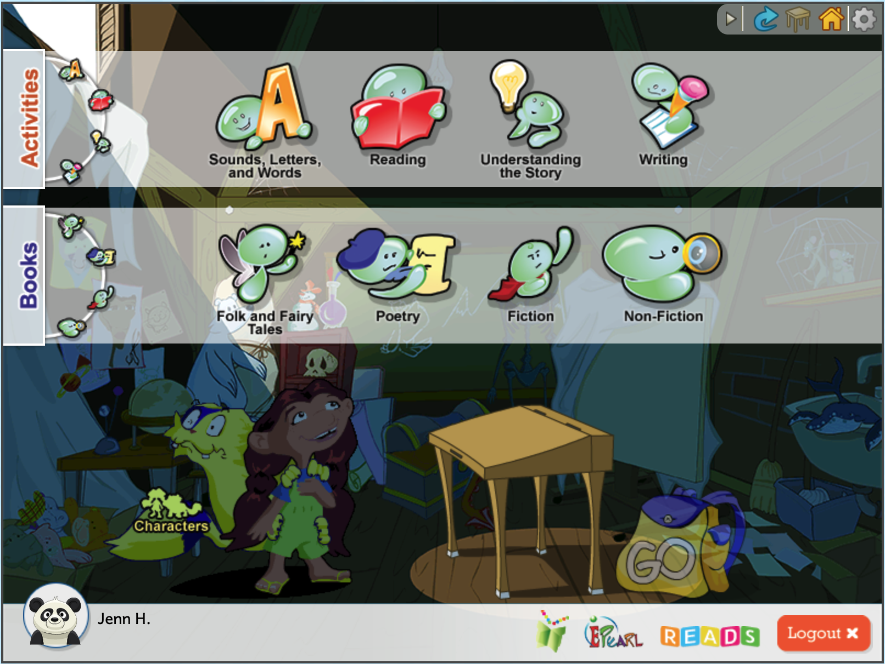
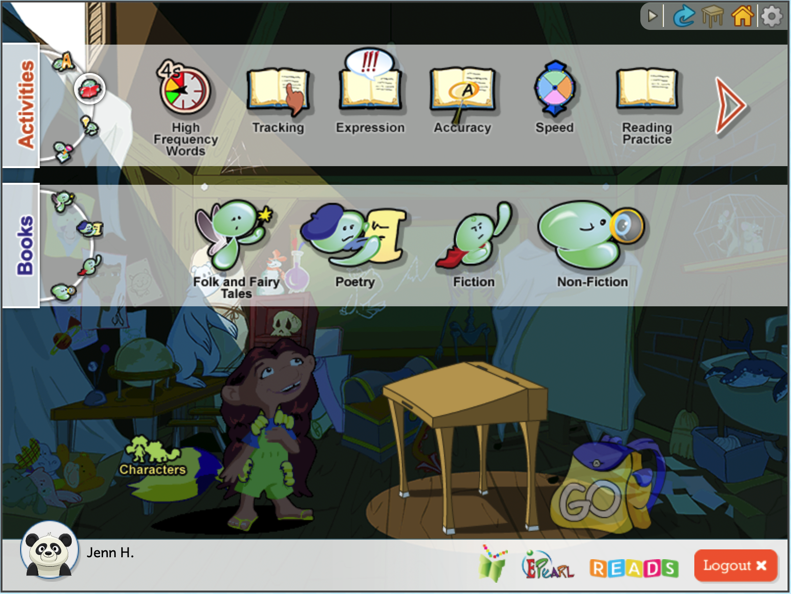
Accessing Fluency Activities
Click on the Reading button.
The fluency activities will be shown in the top banner.
Notes:
You may need to remind them how to access and log in.

Slide 9
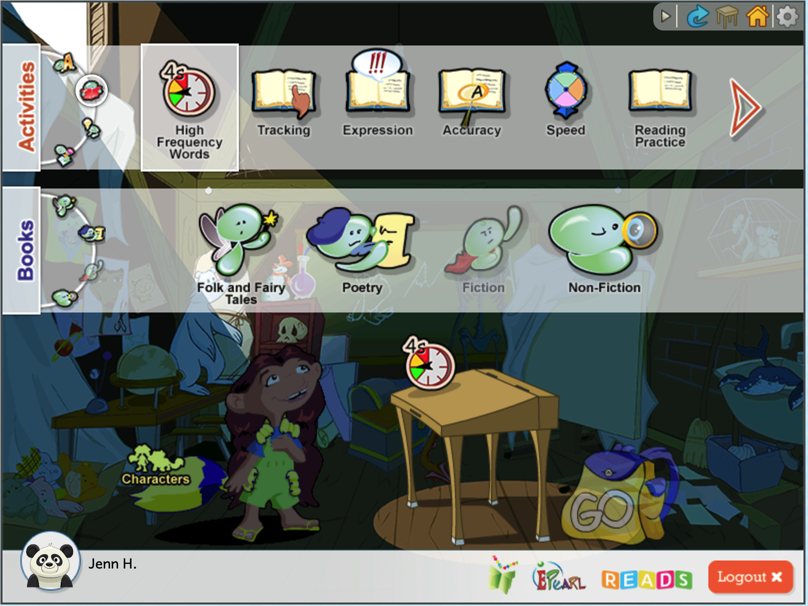
Accessing Fluency Activities
Select the activity: High Frequency Words.
Notice that GO is not yet illuminated. This means that you must connect the activity to an ABRA story.
Select a story genre in the second bar, then select a story of your choice.
Click on Go.
Notes:
You can demo this activity for teachers. Show the steps (like how this activity needs to be connected to a story before you can click on go), talk about the different levels.

Slide 10
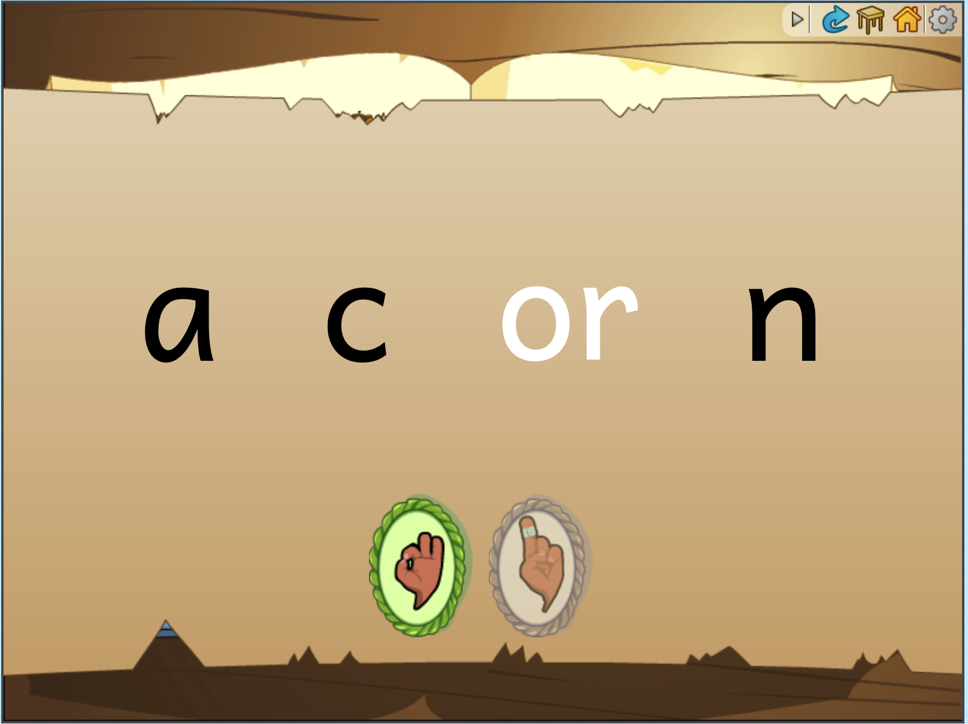
Reminder: Built-in Support
Audio buttons in the ABRA stories can read the page to the child
  Audio-assisted reading
  Echo reading
Clicking on a word launches the built-in decoding support. The word is segmented, and audio for each phoneme is released while visually highlighted. Then the letters get closer together and the process is repeated to help the child blend the word.

Slide 11
Discussion
How can you tell if a child has memorized the story versus being able to read it quickly and accurately?
Some learners might read fluently but not understand what they’re reading. How would you check that they understand what they read?
Share your experiences reading books aloud to children. How do you sound the first time you read aloud compared to tenth time?
Notes:
Some possible answers:
They smoothly point to words as they read them.
Pull out a word from the text & see if they can read the individual word.
You might want to check that they understand by asking them to questions about the story.
The first time reading an unfamiliar story, they might not read it too confidently. They might read slower than normal and use limited expression. However, the more they read, the more they might do so quickly, or develop voices for the characters, and know when to pause dramatically, etc.

Slide 12


Coffee/Tea Break

Slide 13
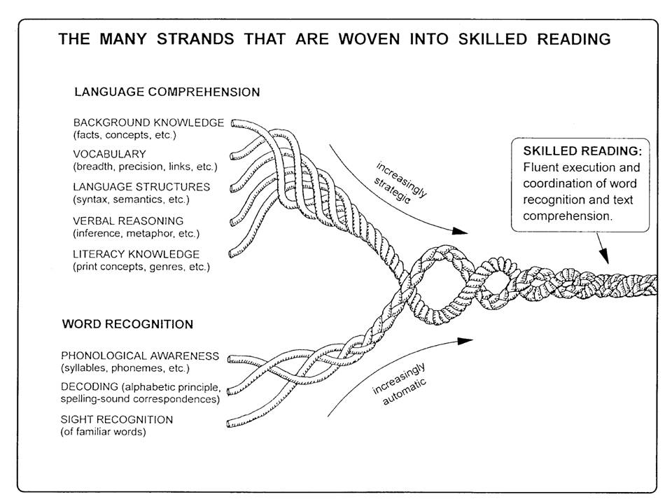
Comprehension: Reading Rope
(Scarborough, 2001)
Notes:
Two parts of reading comprehension: language and word part. Point out parts of reading comprehension. Word recognition is something you’ve done in alphabetics.
Language comprehension: all the things you need to know to be able to understand. We will be teaching them some of this stuff (in the upcoming training).

Slide 14
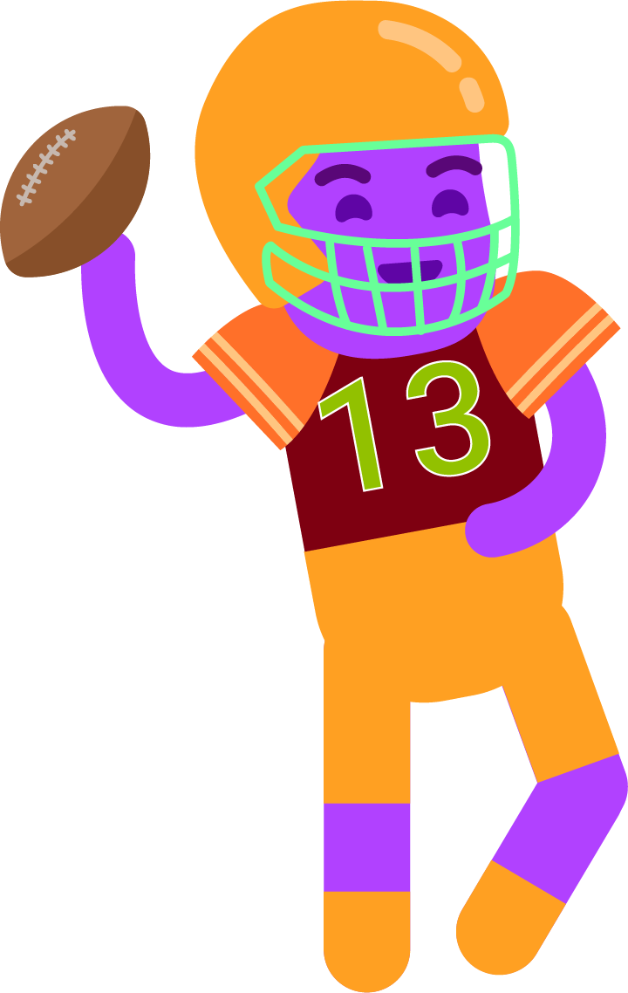
Other Components to Understand Text
Vocabulary
Morphology (parts of words)
Syntax (grammar)
Background knowledge
General knowledge
Notes:
Vocabulary, background knowledge and experience:
American football: downs, back heel, center spot, cross, corner flag, dribble (https://www.topendsports.com/sport/soccer/terms.htm)
Cricket game: overs and unders
Snow: different types of snow. Big deal if you ski.
Morphology: ‘Downs’ in a noun, but ‘fall down’ descriptor.
Everything the learner brings to the table. It is all their past experiences, prior knowledge, vocabulary, how they understand words in a sentence. This is why it is hard to do.

Slide 15
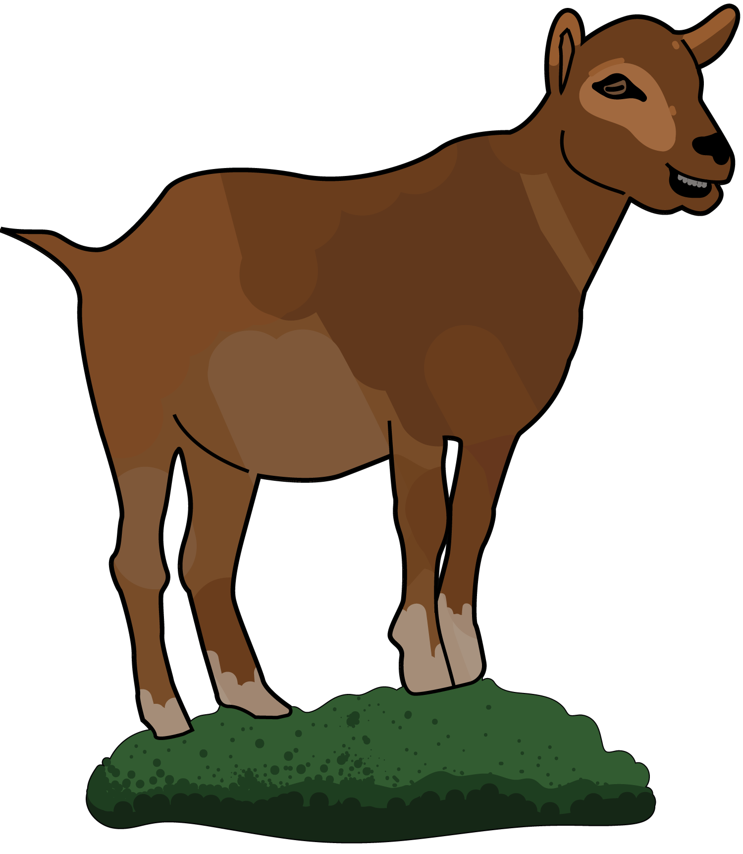

Vocabulary
Build on Prior Knowledge
Categorize
Start with familiar words: animals, items in the classroom.
Categorize: farm animals vs. wild animals.
Categories help organize.
Learn to use English for conversation.
Farm | Wild
Goat | Elephant
Cow | Lion
Chicken | Gorilla
Donkey | Zebra
Notes:
Can go with themes of the class.
Conceptual knowledge: what do you know about animals that can transfer?
Prior knowledge from first language: do you know that word in your first language? Here is what it is in English
What you learned in school. Not just what your teacher said and you repeat it. Communicative language. Learning how to have a conversation not just individual words. “How are you?” you can say more than just “I am fine” but “I am happy” etc. Teacher could also change the prompt “How was your day?”

Slide 16
Imageability
Some words are easier to teach as you can point to it (desk, dog). But if you keep words too simple, no one will catch up.
It’s harder to teach words such as “like” (I like this) or “delicious”.
Start with words that are in the environment, or important words, or in the stories. Then figure out how to teach the harder words.
Desk, chair, table → furniture (classify, less common word).
Notes:
For a word like ‘like’ you might want to rely on translation (in the language you speak at home this word is…). Build on prior knowledge.
Everyone’s idea of ‘delicious’ might be different. Some might associate with cake, while others might be pizza, or another favourite food.
Go back to animals: can teach animals and categories. Then teach a harder words like Habitat
New words (curriculum). What are the new words for your class.

Slide 17

Understanding the Story (Comprehension)
Comprehension, which is reading for meaning, is the goal of learning how to read. To fully comprehend a text, readers needs many skills including word decoding, vocabulary recognition, reading strategies (for when they don’t understand), and a set of experiences and knowledge of the world.
The activities in ABRACADABRA provide children with practice in all the key comprehension skills. Many of these activities can be done in small groups, with children sharing their answers and receiving feedback from peers or the teacher. Children also need plenty of time to read individually, and with adults.

Slide 18
Using ABRA to Support Comprehension
ABRA offers 8 activities to support children as they learn and practice comprehension skills. Six of these activities are focused on comprehension and two activities on vocabulary.
Comprehension, which is reading for meaning, is the goal of learning how to read. Children should combine their decoding skills with vocabulary recognition, reading strategies, and their own experiences and knowledge of the world.
Vocabulary refers to the words we use to communicate successfully. Direct vocabulary instruction should focus on words that are used frequently at school but that children have not learned in other contexts, for example at home or on the playground.

Slide 19
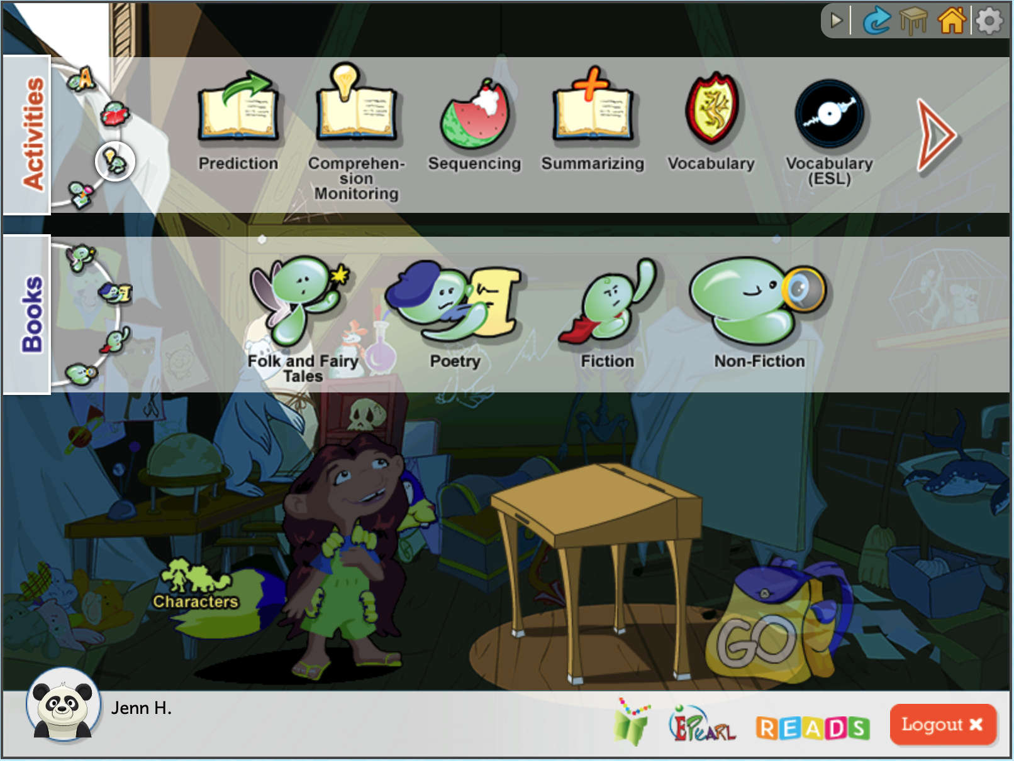
Accessing Comprehension Activities
Click on the Understanding the Story button.
The comprehension activities will be shown in the top banner.

Slide 20
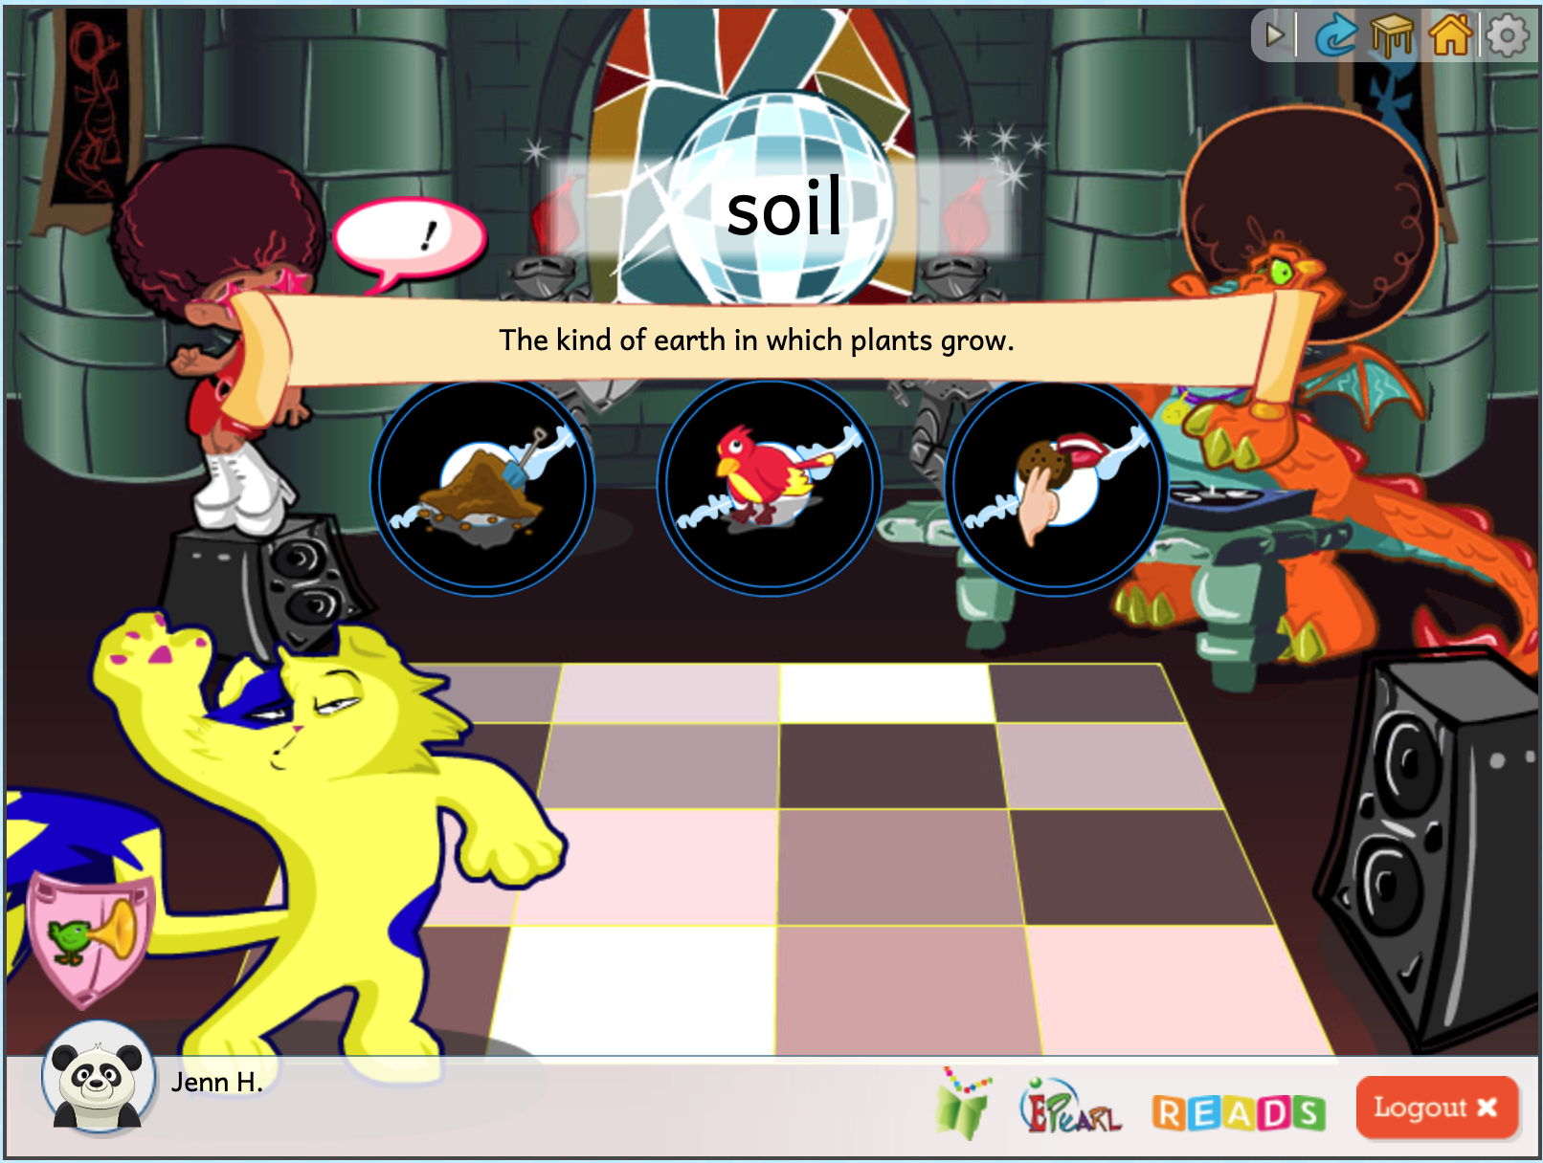
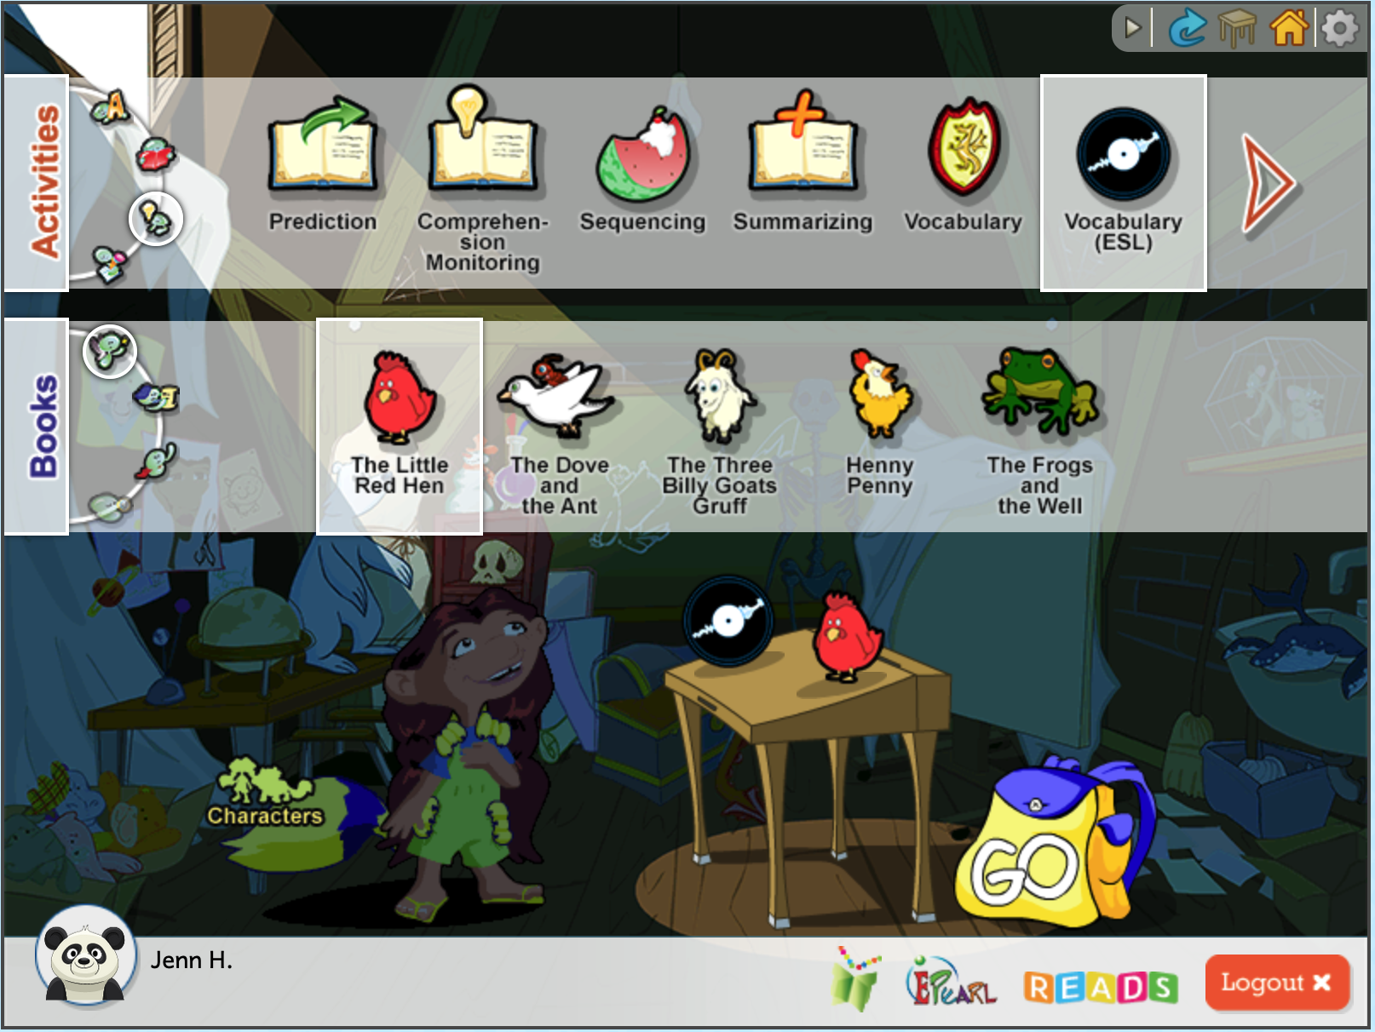
Accessing Comprehension Activities
Select the Vocabulary (ESL) activity.
Select any book.
Click on the Go button.
Watch the demo.
Press on the Play button.
Try the activity.
Make some errors to see what kind of visual and audio support is provided.
Notes:
Depending on the timing, you might want to demo one of these activities. Teachers should explore on their own later.

Slide 21
Discussion Questions
What do you do when you don’t understand something that you’ve read?
How do you ensure your students understand a text you’ve given them?
What teaching strategies have you tried in your classroom to foster students’ writing skills? What worked and what didn't?
Notes:
Reread but only want to do that now and then. Doing this all the time takes too long.
Judge how hard a passage for the children. If they have to reread everything then it is too hard. Don’t leave it too long – check frequently at first.
Sentence, passage, page, chapter: build.
Learners can get it from each other too. It may happen more often in larger classes.
Maybe no one knows, so they put up their hand for help. The teacher could stop and explain to the whole class – if there is a whole group that doesn’t understand, chances are more learners in the class don’t know as well.
Don’t wait until the end. Jump in as soon as you realize children may not understand the story/vocabulary. “Oh, this is a tricky word. What do you think X means?” some learners may volunteer to answer, but if no one does the teacher can provide the definition.
Framing at the beginning also helps them understand how to put it together. Bookened: framing at beginning, and checking at end.

Slide 22
Writing (Typing)
Comprehension, which is reading for meaning, is the goal of learning how to read. To fully comprehend a text, readers needs many skills including word decoding, vocabulary recognition, reading strategies (for when they don’t understand), and a set of experiences and knowledge of the world.
The activities in ABRACADABRA provide children with practice in all the key comprehension skills. Many of these activities can be done in small groups, with children sharing their answers and receiving feedback from peers or the teacher. Children also need plenty of time to read individually, and with adults.

Slide 23
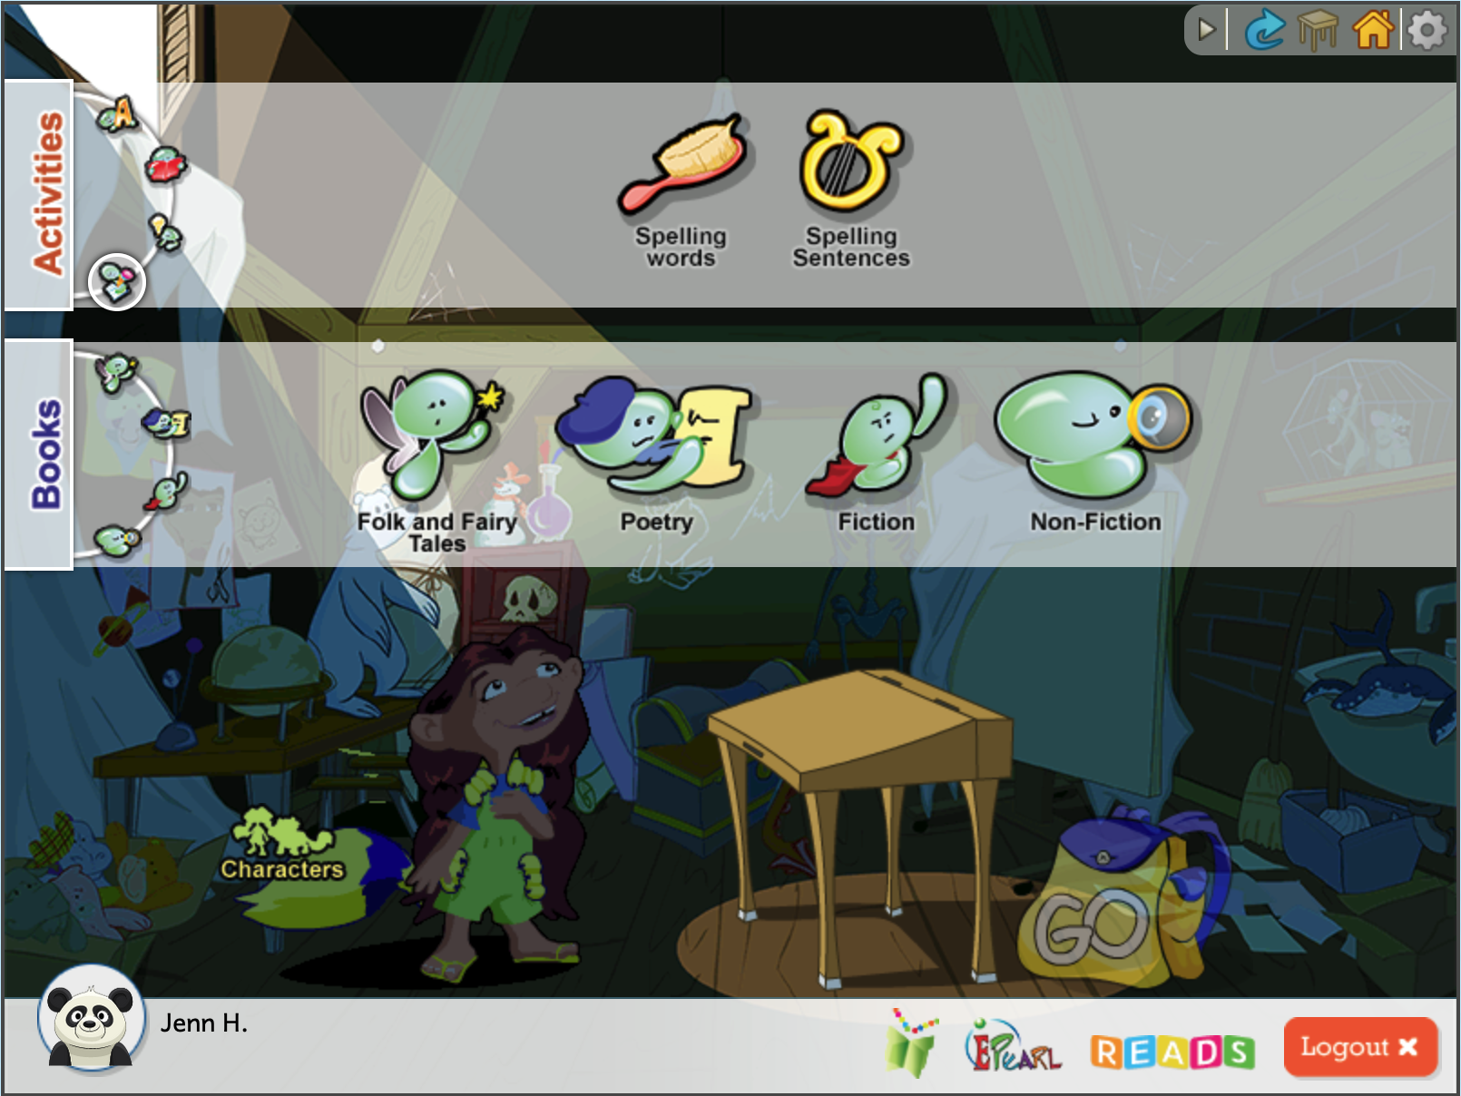
Accessing Writing Activities
Click on the Writing button.
The writing activities will be shown in the top banner.
ABRA has two activities to help children build these skills. One focuses on individual words, and the other activity centers on typing full sentences

Slide 24
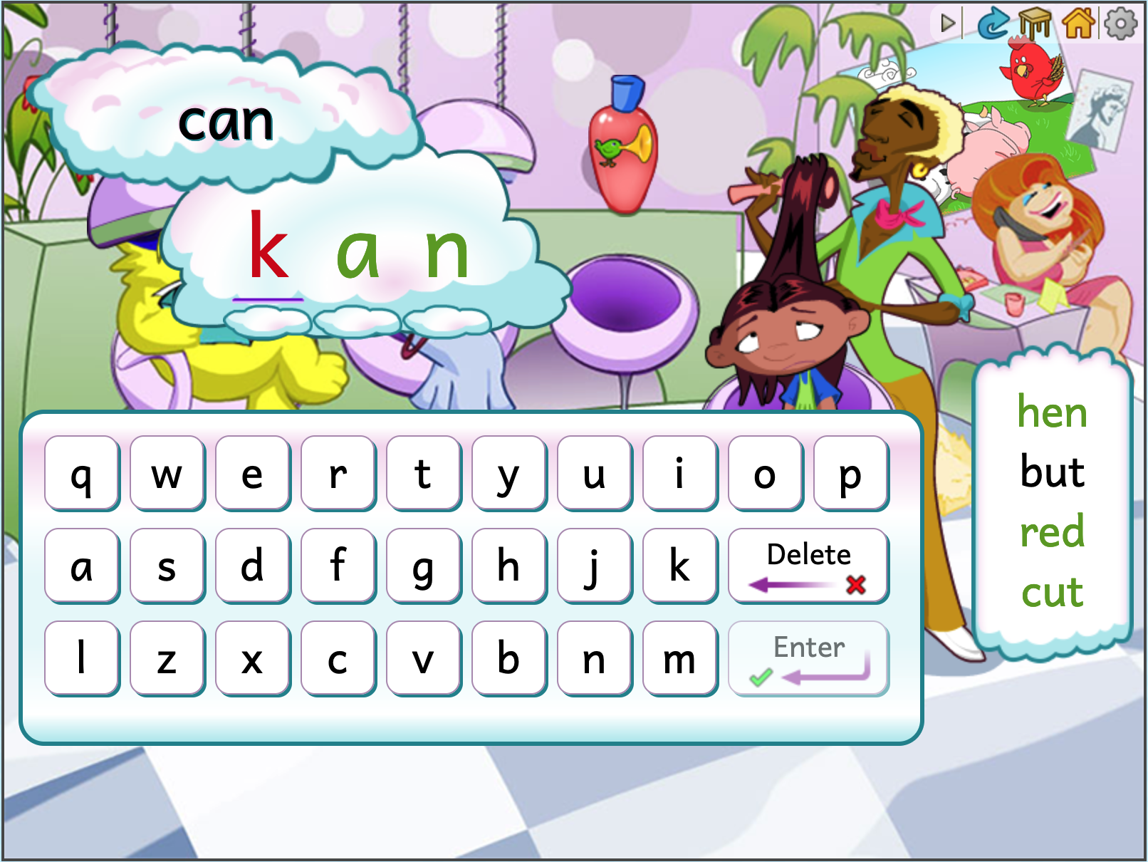
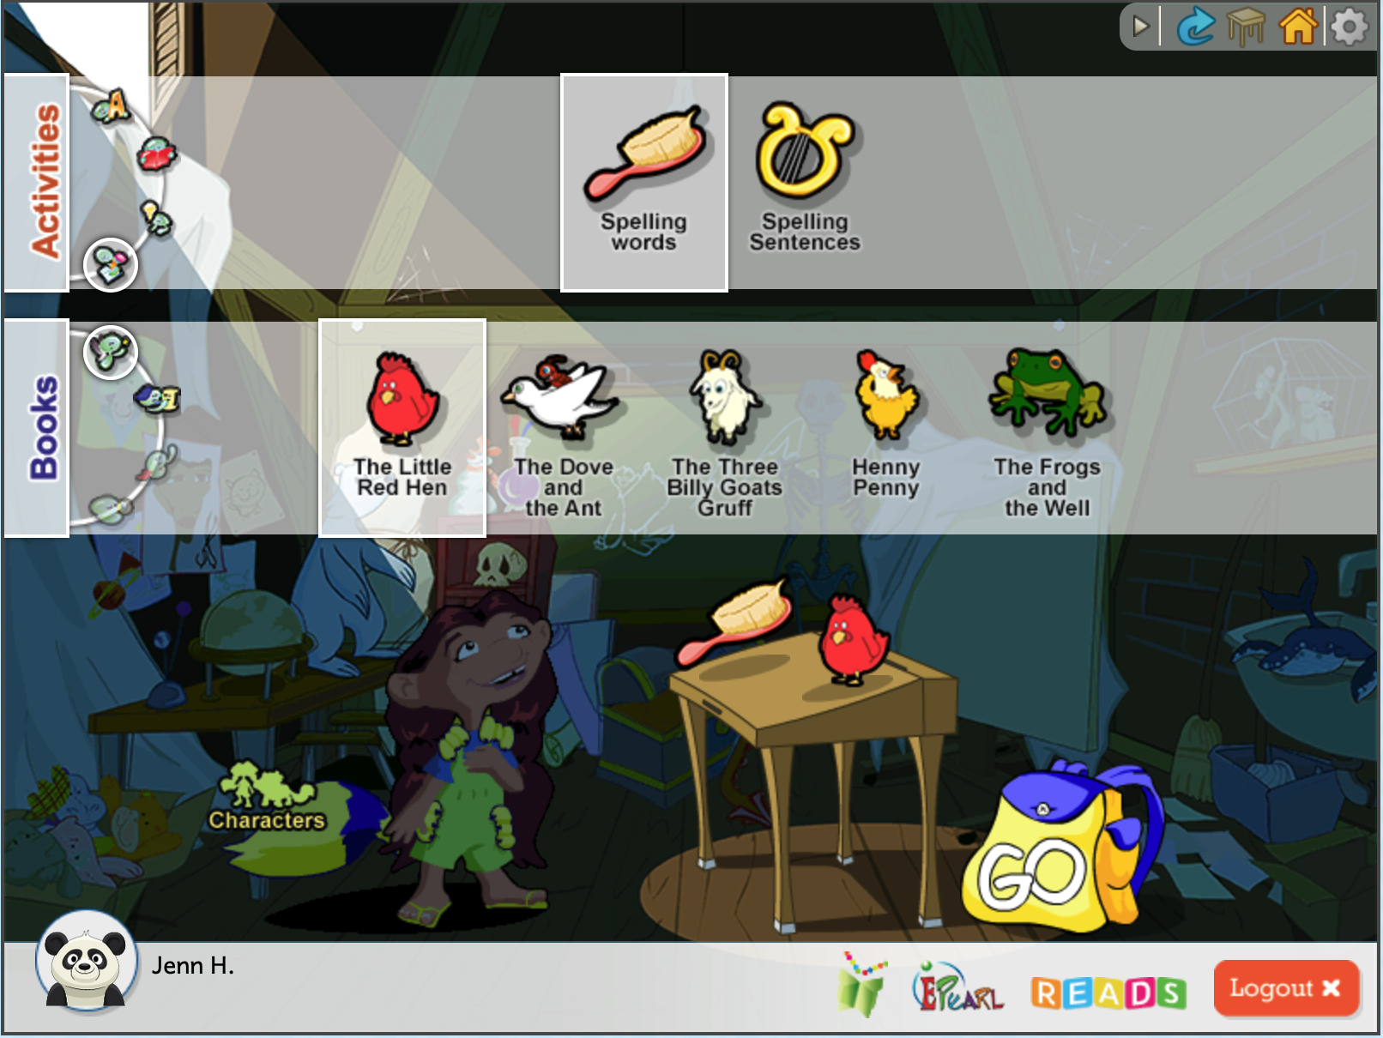
Accessing Writing Activities
Select the Spelling Words activity.
Select any book.
Click on the Go button.
Watch the demo.
Press on the Play button.
Try the activity.
Make some errors to see what kind of visual and audio support is provided.
Notes:
Depending on the timing, you might want to demo one of these activities. Teachers should explore on their own later.

Slide 25
Curriculum Connections
Do you see these activities working for your classroom?
  Are you ready to try it, or do you have questions first (if so, what are they?)?
Identify some successes you foresee when taking learners through these activities.
What are the challenges you foresee?
  How can they be addressed or overcome?
  Is there an alternative activity that might work better? Why?
Generate one concrete example that you could use when talking to parents about Fluency, Comprehension, or Writing.

Slide 26

Questions?

Slide 27
Break

Slide 28
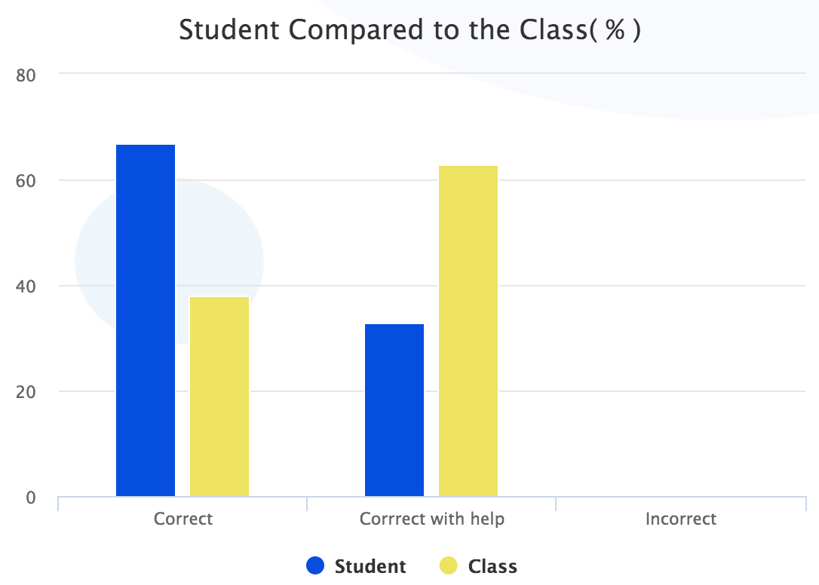
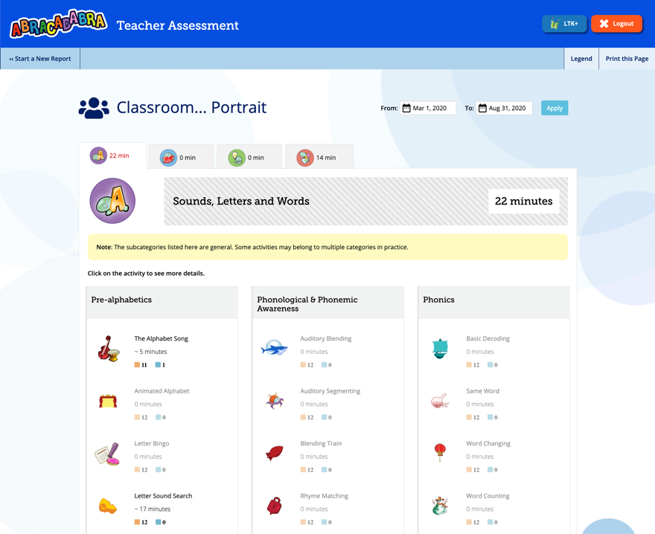
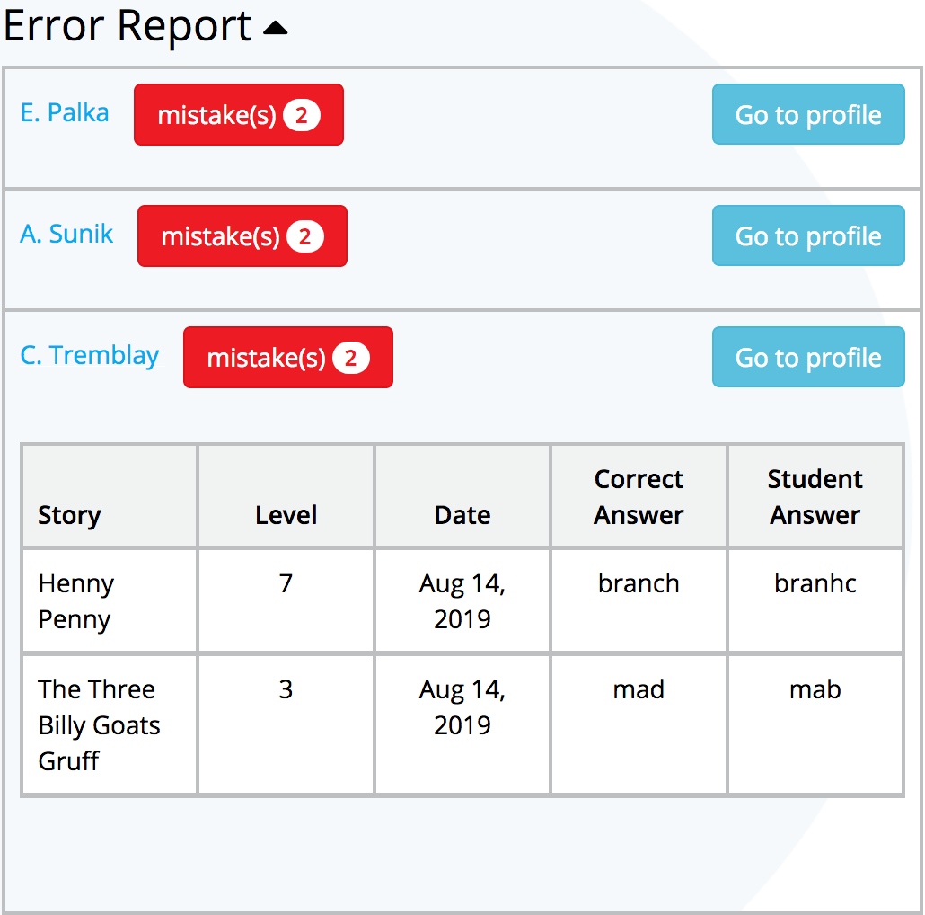
ABRA’s Assessment Feature
ABRA allows teachers to*:
Quickly see which activities their
learners have attempted.
Determine how much time was
spent on each activity.
See how their learners are doing as
they progress through the activities.
*To be used successfully, each child
must be signed into their own account.
Learn more with the TPD Module: ABRA Assessment
Notes:
Demo the assessment feature (needs a populated account).
You could also direct them to this teacher aid: https://literacy.concordia.ca/resources/abra/shared/downloads/res/ta/ABRA-TA-Assessment-20230512.pdf

Slide 29
ABRA’s Assessment Feature
Log in to a teacher’s account.
From the lobby page, click on the cog icon near the ABRA logo.
Use the drop-down menu to select the class.
TBD: Will you provide teachers with “dummy” student accounts and encourage them to use those during the exploration phases of training (encourage them to make some errors to populate the report), or will you set this up yourself to ensure there is a range of data to demo?
Determine if you need to edit the date range. By default it’s the last 30 days, but you may want to view by term or whole year’s progress.
Demonstrate the kind of information you can see in the class report.
  Overview (time, which activities accessed, how many students completed activity, etc.).
  Induvial activity reports vary, but can show stats on errors, error report, what stories were linked to the activity, what words might have been clicked on for support, and a percentage of how many students completed the activity. If the activity has multiple levels, you can filter the information by level using the dropdown menu. The error report can direct you to an individual student’s report, or you can start over.
Demonstrate the kind of information you see in the student report. Must select a student first.
  Overview (time, which activities accessed, what/if levels were completed, etc.).
  Induvial activity reports vary, but can show stats on errors, error report, what stories were linked to the activity, what words might have been clicked on for support, and a comparison of that student correct responses to the class average

Slide 30
Importance of Logging In and Out
The assessment feature, as well as trace data for this study, requires students to log in and out of their own accounts in order for the information to be accurate.

Slide 31
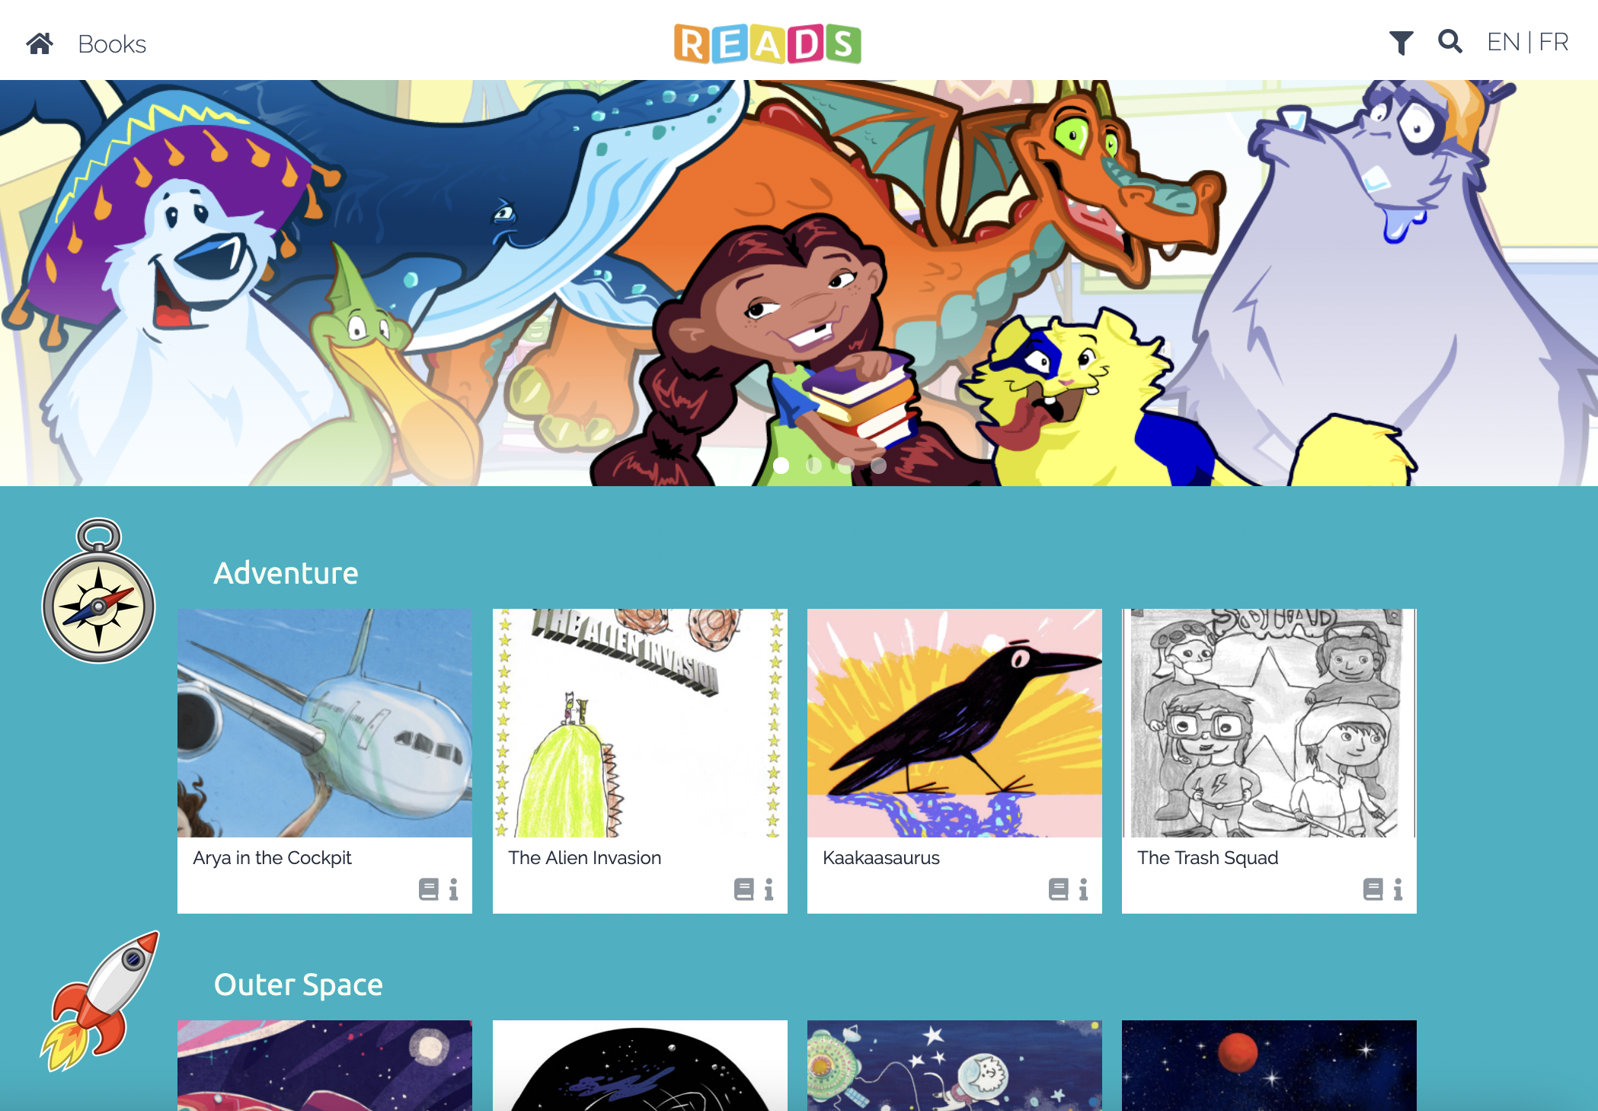
READS Introduction
Catalogue of hundreds of multi-national digital stories.
Stories may be searched by keyword, theme, reading level, country of origin, language, and format.

Slide 32
Introducing Books
Some children will come to your classroom with no experience reading books. Consider trying the following strategies with them:
Ask the child to identify familiar objects in the pictures. They can do this in their mother tongue, and the teacher can reinforce the word in English.
As you read the story “I Can Move Like a…” with them, have them imitate the movements each animal makes. i.e. they jump when the cat jumps.

Slide 33
Explore READS: Group Activity
There are many books available in READS. Explore the tool by finding a book:
  About animals
  About the environment
  That is easy to read
Select a book in READS that you think would work for your classroom.
Pick 3 words in the book you think your learners would struggle with. Consider words that are:
  Hard to decode
  Likely to have students struggle to read quickly.
  Unknown vocabulary
How can you make it easier for your students to read these words?

Slide 34
Curriculum Connections - Discussion
Do you see these stories working for your classroom? Why or why not?
Identify some successes you foresee when incorporating these books in your lessons.
What are the challenges you foresee?
  How can they be addressed or overcome?
  Is there an alternative story that might work better? Why?
How else might you use these stories in your classroom or school?

Slide 35

Questions?

