Slide 1
Teaching Early Literacy with the Learning Toolkit+
A Teacher Professional Development Course
Day 2
Notes:
Legend for highlighted text in this document:
Yellow highlights: for facilitators to adjust.
Green highlights: if relevant, otherwise could be deleted. Maybe require facilitators to adjust if kept.

Slide 2
Agenda – Day 2
Overview of the LTK+
Overview of ABRA
  How it was designed
  4 key skills
  Resources for this cohort
Alphabetics
  Review key sub-skills
  Explore ABRA
  Curriculum connections
Teacher Resources
Housekeeping / Reminders
Insert as needed (ex: collecting expectation forms or other missing registration information)

Slide 3
Contextualization
Activity : Think, Pair and Share
What have you been doing so far in your English lessons?
How do you engage students in literacy in the classroom?
What do you want to change or improve upon in your teaching strategies?

Slide 4
Accessing the LTK+
Insert link to the installation, local version, or LITE version you expect teachers to use
Anything you need to add about how/when they’ll receive their account info?
Tip: Create a thumbnail shortcut on the devices that students will be using for easy access.
Notes:
Demo the process for accessing the version your participants will be using.

Slide 5
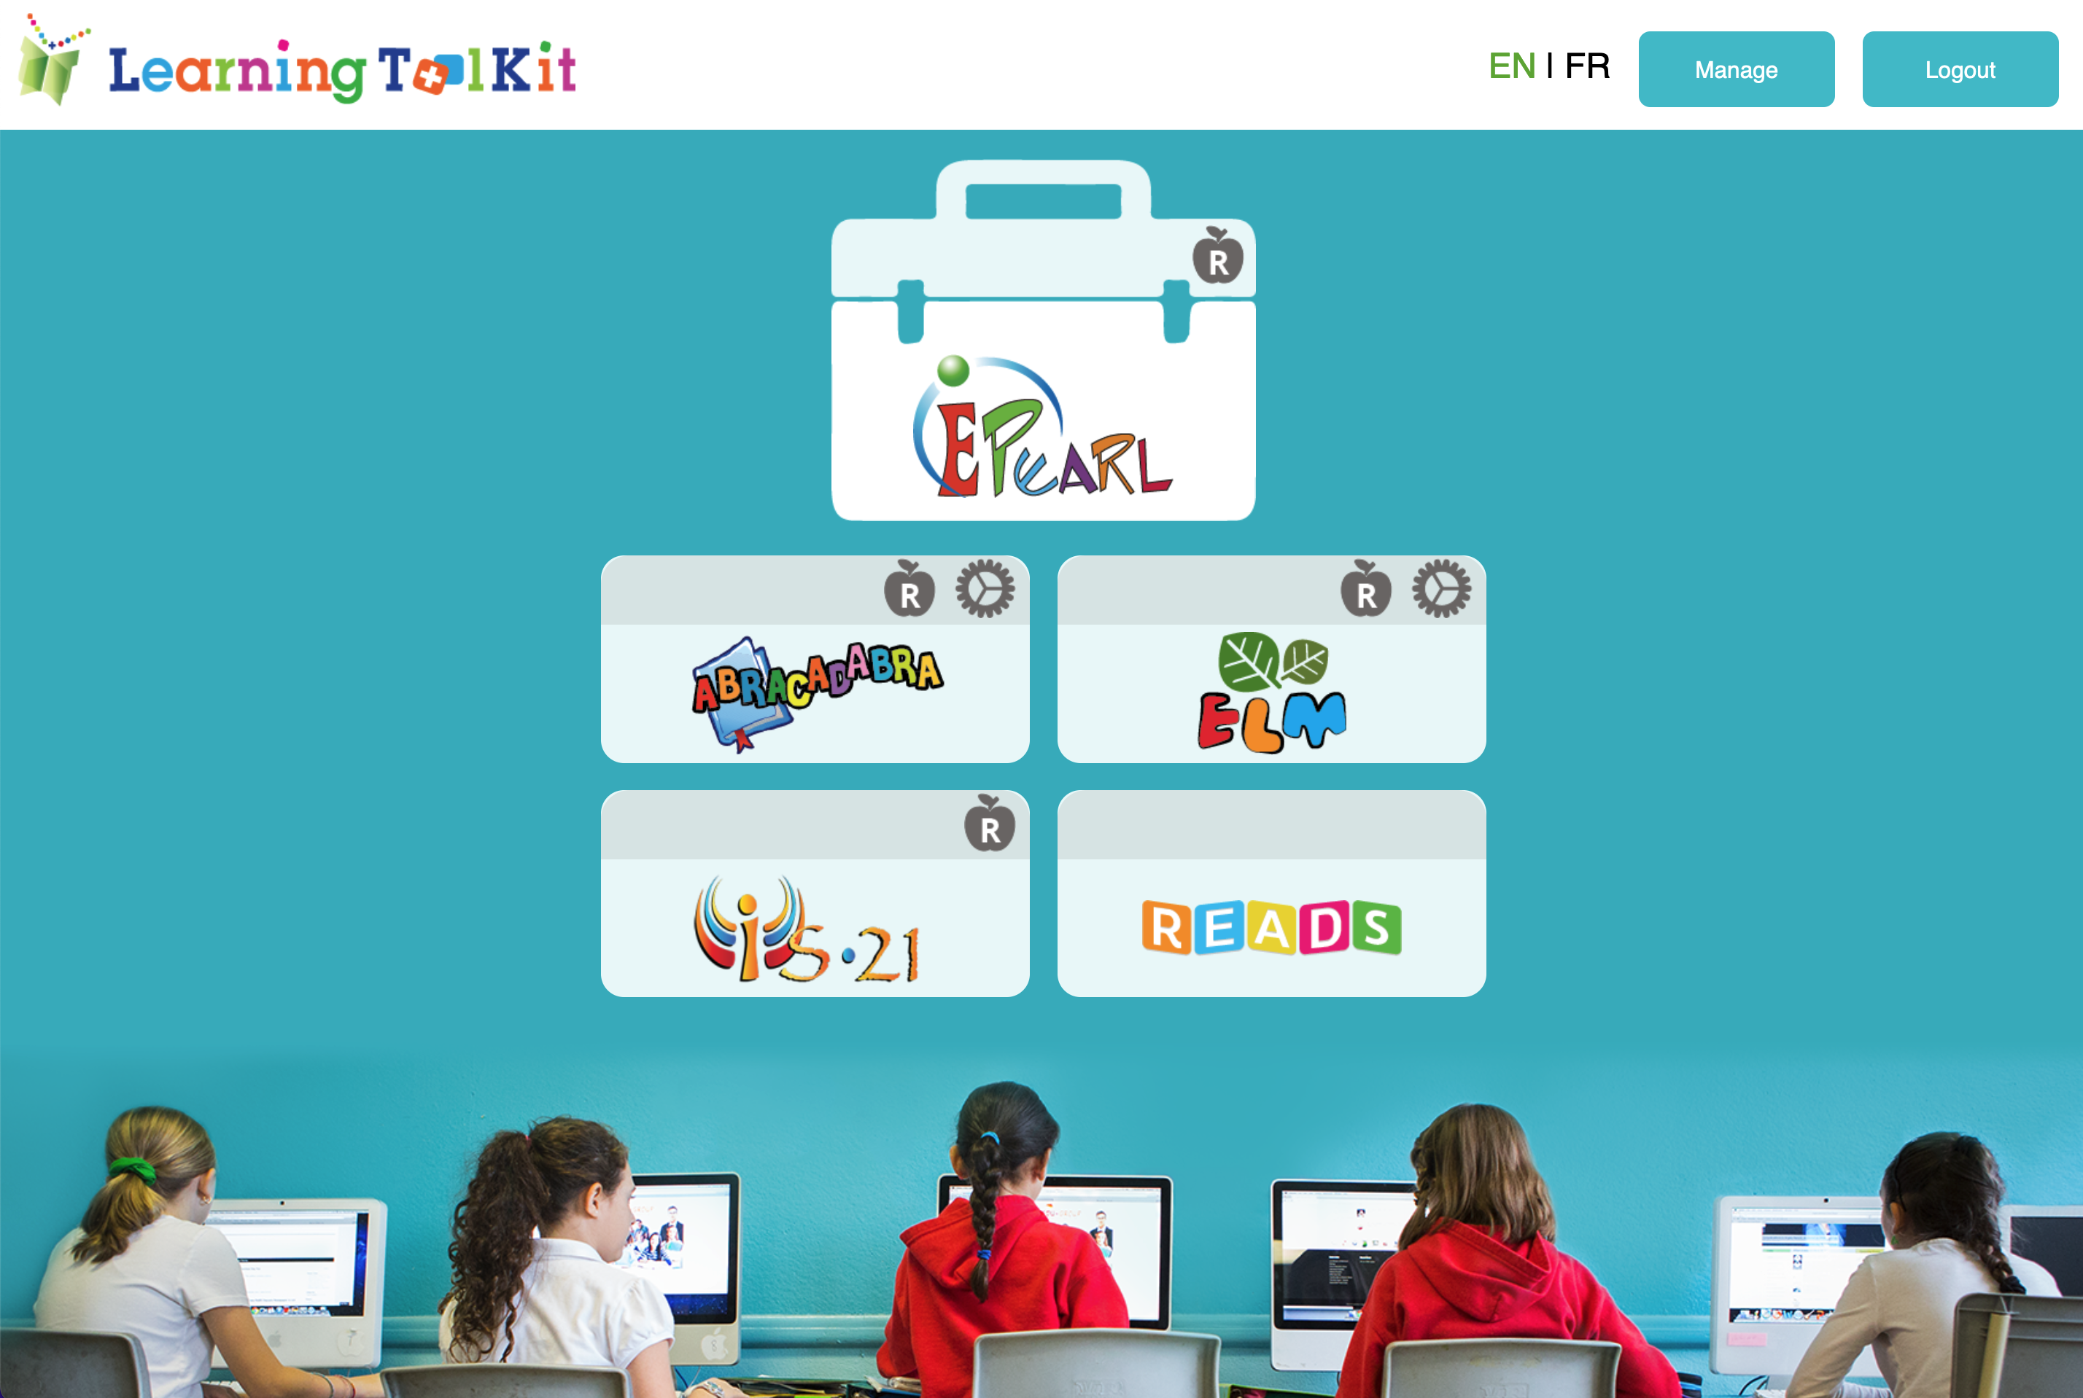
Overview of the LTK+
Designed to build foundational skills
Literacy
Evidence-based & evidence-proven
Numeracy
Self-regulated learning
Used internationally
Information literacy
Winner of the UNESCO King Sejong Literacy Prize
Notes:
ABRACADABRA: A Balanced Reading Approach for Children Always Designed to Achieve Best Results for All
READS: Repository of Ebooks And Digital Stories
ELM: Emerging Literacy in Mathematics
ePEARL: Electronic Portfolio Encouraging Active Reflective Learning
IS-21: Inquiry Strategies for the Information Society of the Twenty-First Century

Slide 6
Overview of the LTK+
There are teacher accounts and student accounts.
The teacher accounts have extra icons:
  Resources: links to a website on Concordia’s servers – need an internet connection (we’ll explore this more later today)
  Assessment (more on this in Day 3)

Slide 7
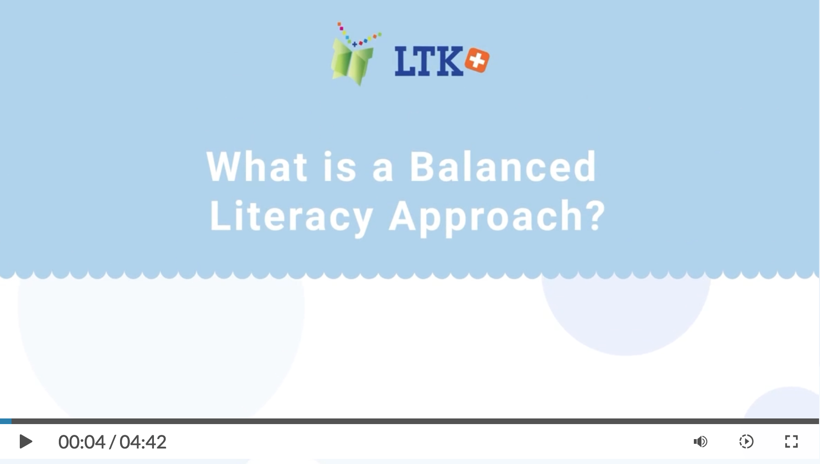
Overview of ABRA
Balanced literacy approach
Designed for beginning readers
4 key literacy skills: alphabetics, fluency, comprehension, and writing
Evidence-based: National Reading Panel
Evidence-Proven: Many international studies (including third party evaluations)
Notes:
Evidence-based: Here what is important to get across is that ABRA was designed by a multi-disciplinary team (subject matter experts, instructional designers, developers, researchers, practitioners, pedagogical consultants) and was based on the National Reading Panel’s comprehensive review (2000) https://www.nichd.nih.gov/sites/default/files/publications/pubs/nrp/Documents/report.pdf
…on how children learn to read –specifically early literacy instruction needs to focus on four broad skill areas which each contain various sub-skills. Each activity within ABRA is linked to one of these sub-skills… resulting in a balanced approach to literacy instruction (There have been various subsequent reviews since this one, however the core findings remain in terms of the necessary sub-skills.)
An iterative approach was used where the software was tested with pilot teachers and rejigged based on findings.
(if didn’t play on Day 1) Play video in the Getting Started with ABRA module: https://literacy.concordia.ca/tpd/mod_started/story.html
Use the table of content menu – select the ABRACADABRA section then click on “What is a Balanced Literacy Approach?”
Evidence-proven: Dozens have rigorous experimental studies have been conducted on ABRA across the world (Canada, Hong Kong, Bangladesh, Kenya, Rwanda, England, Australia) some by third parties. All of these studies have shown that children learn to read when they use ABRA regularly. And the results spill over into other subject areas.

Slide 8
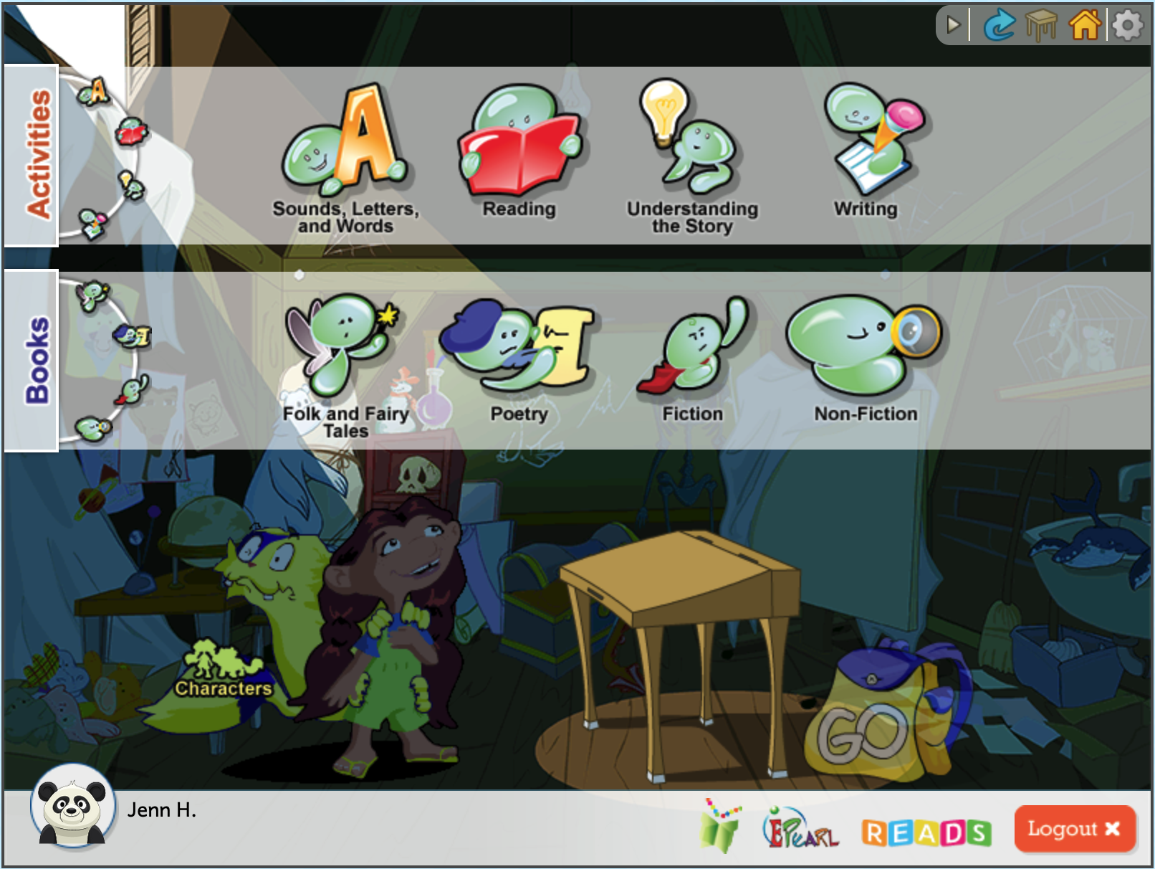
Overview of ABRA
Sounds, Letters, and Words – Alphabetics
  Pre-Alphabetics
  Phonological and Phonemic Awareness
  Phonics
Reading – Fluency
Understanding the Story – Comprehension & Vocabulary
Writing - Typing
Notes:
ABRA is a set of engaging, interactive activities designed to build early literacy skills in:
• Alphabetics: This skill refers to the ability to associate sounds with letters and then to use those sounds to create words.
• Fluency: This skill refers to the ability to read a text out loud accurately, at the proper speed, and with expression.
• Comprehension: This skill targets reading for meaning, which is the goal of learning how to read. In ABRA, this category also covers vocabulary, which refers to the words used to communicate successfully.
• Writing: This skill addresses the use of letters and words to create sentences and texts for others to read.

Slide 9
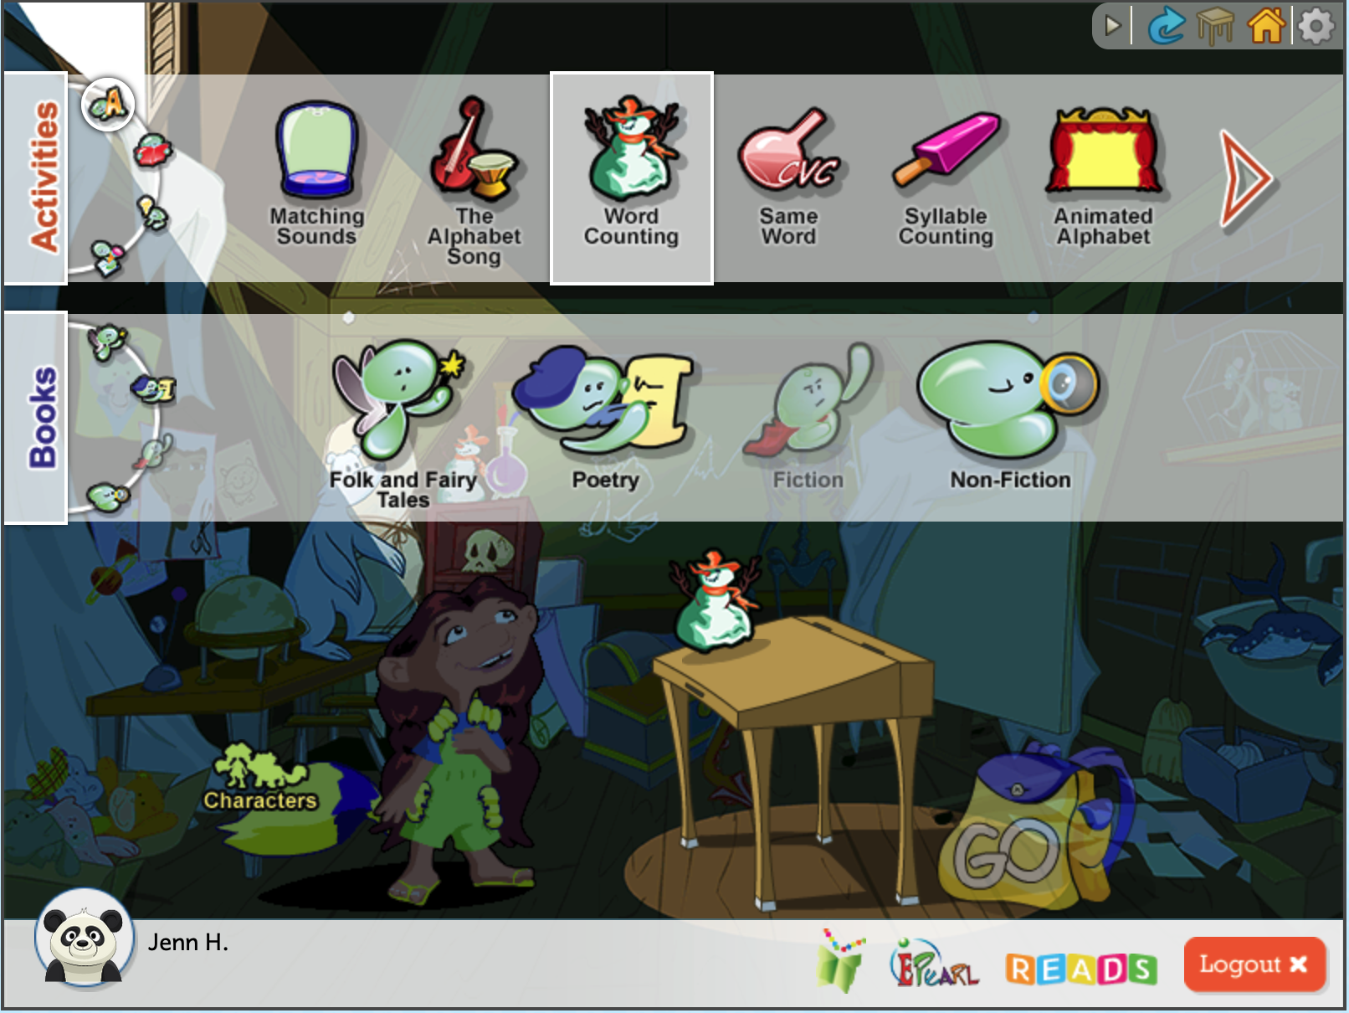
Overview of ABRA
Flexible – no set path. Can be tailored to different contexts and students’ needs
33 activities & 20 stories
Plus 15 student stories
Some activities must be connected to a story
Each activity has a demo video so students know what to do
Notes:
Flexible - no required path, customizable for particular individual needs, single or multiple student use, classroom/lab, at-home, etc.

Slide 10

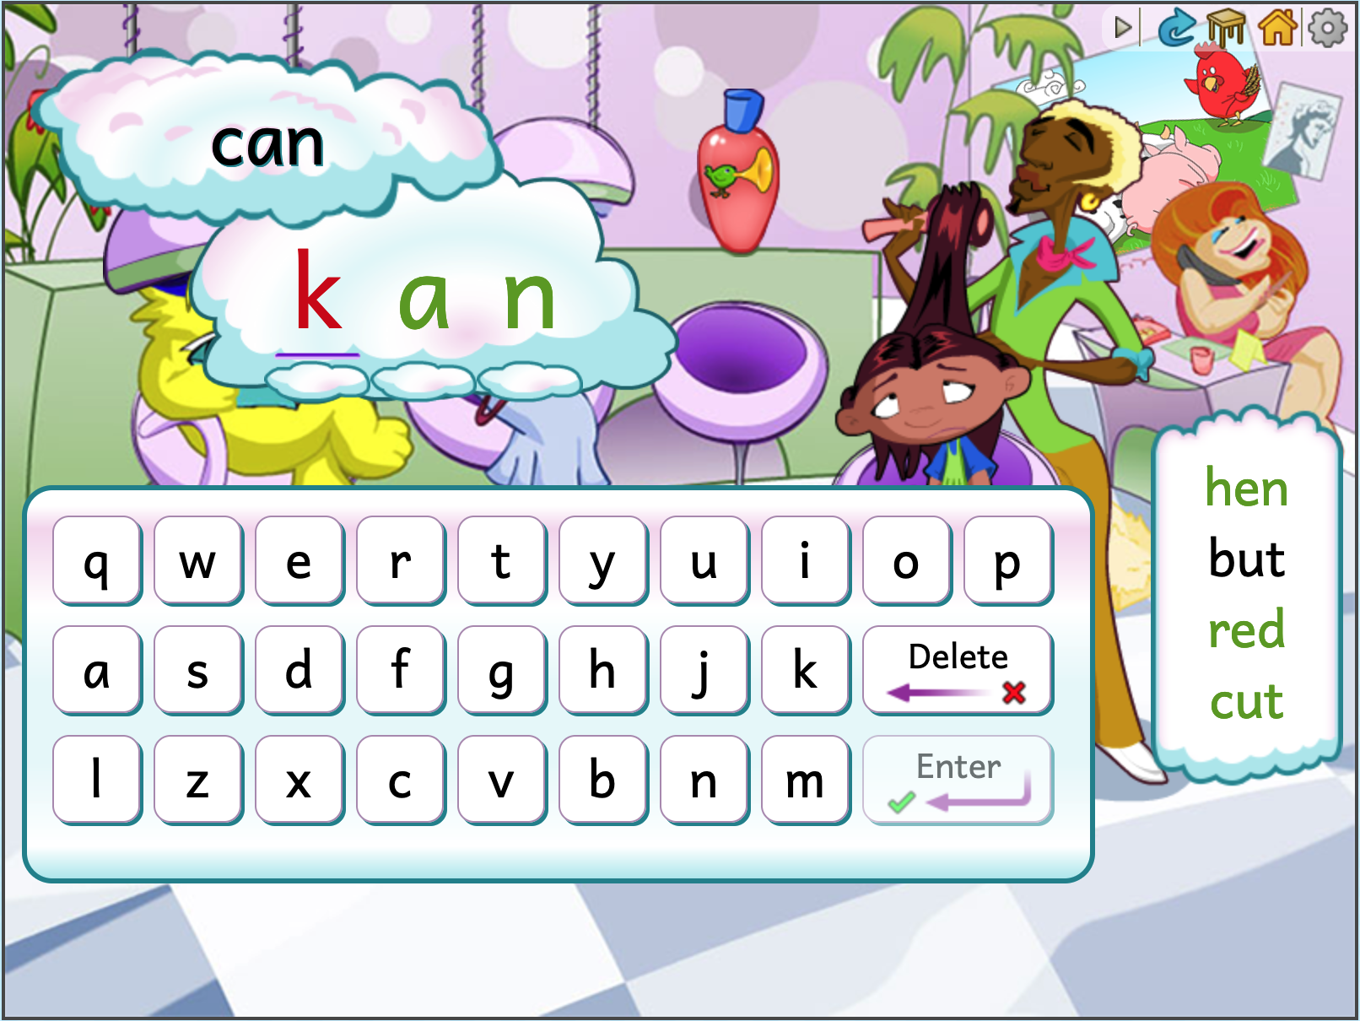

Overview of ABRA
Built in Scaffolding and Support
ABRA displays correct spelling after two erroneous attempts
Audio buttons
  Repeats instructions
  Read the story
Help buttons
Errors: audio and visual clues to try again
Different levels (some activities) to support differentiation and gradually develop a skill
Notes:
ABRA supports students with auditory and visual cues therefore permitting them to work individually and without disturbing others.
Spelling Words Error: An example of the support provided for errors. If the child cannot self-correct after an audio-only prompt, ABRA shows the correct spelling for them to copy. On the right side of the screen is a list of previous words the user attempted with green font indicating correct attempts, and black fonts indicating they made an error but corrected it and moved on.

Slide 11
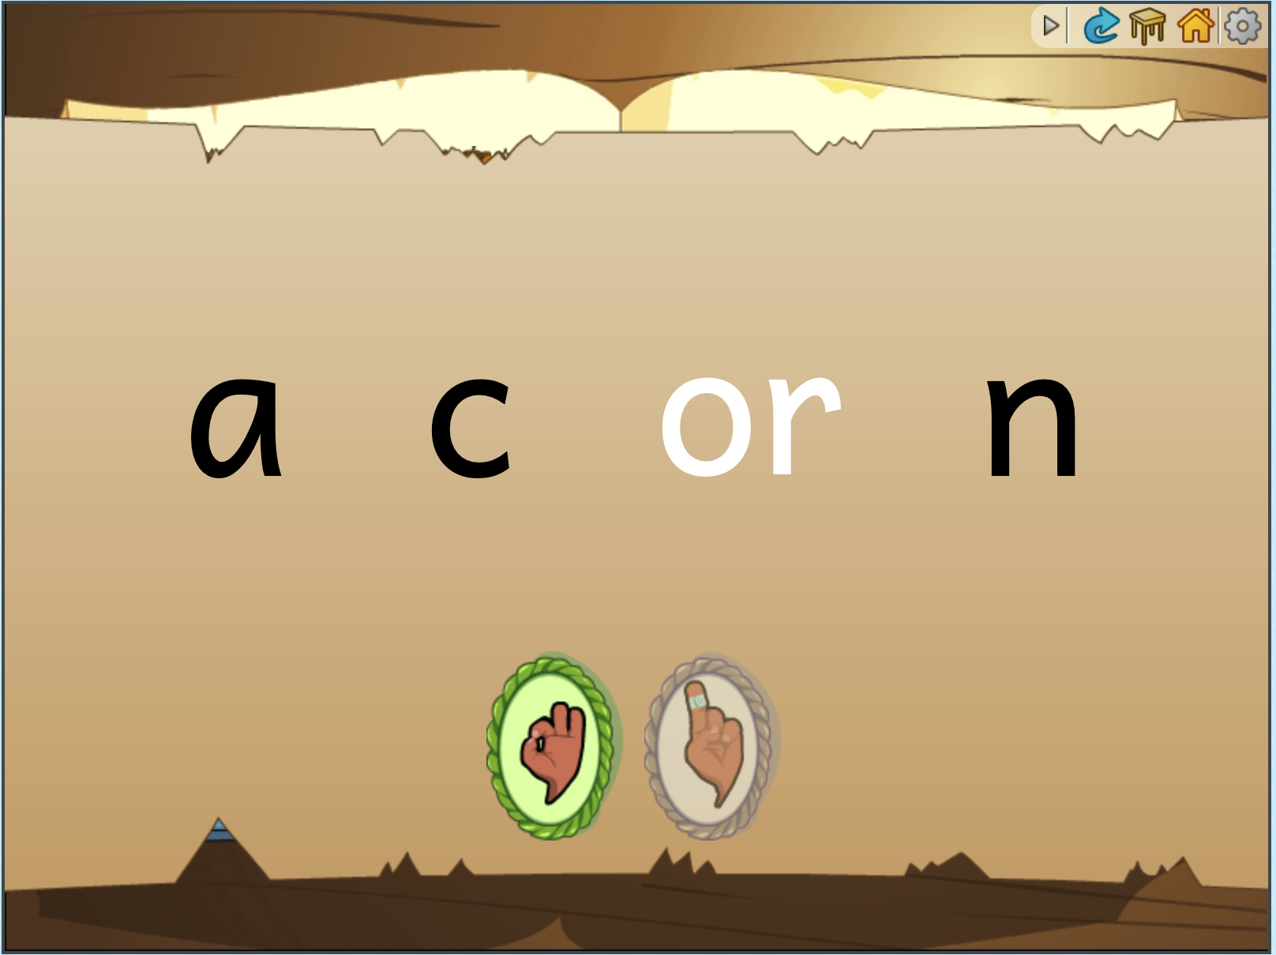
Overview of ABRA
Audio buttons in the ABRA stories can read the page to the child
  Audio-assisted reading
  Echo reading
Clicking on a word launches the built-in decoding support. The word is segmented, and audio for each phoneme is released while visually highlighted. Then the letters get closer together and the process is repeated to help the child blend the word.
Notes:
This will be explored more during day 2 of training.
Except for sight words, the words they clicked on and asked for help with will be phonetically broken down. This encourages students to look carefully at the word in the hope that they will remember it the next time they see it. This invites and enables them to visit the books many times without peer, teacher, or parent support. This repetition builds literacy skills as their word knowledge grows.

Slide 12
Relevant Resources
Insert, if relevant, specific resources that would be of interest for participants in your cohort. For example, if there’s an alignment guide for ABRA/READS and the local curriculum, now would be a good time to introduce it, pass out hardcopies or let them know how to access it online.
Use the resources to express that ABRA/READS supports what they already do rather than being an add-on or extra burden.
Other possible resources could be: job aids or lesson plans created specifically for this population, etc.

Slide 13


Break

Slide 14
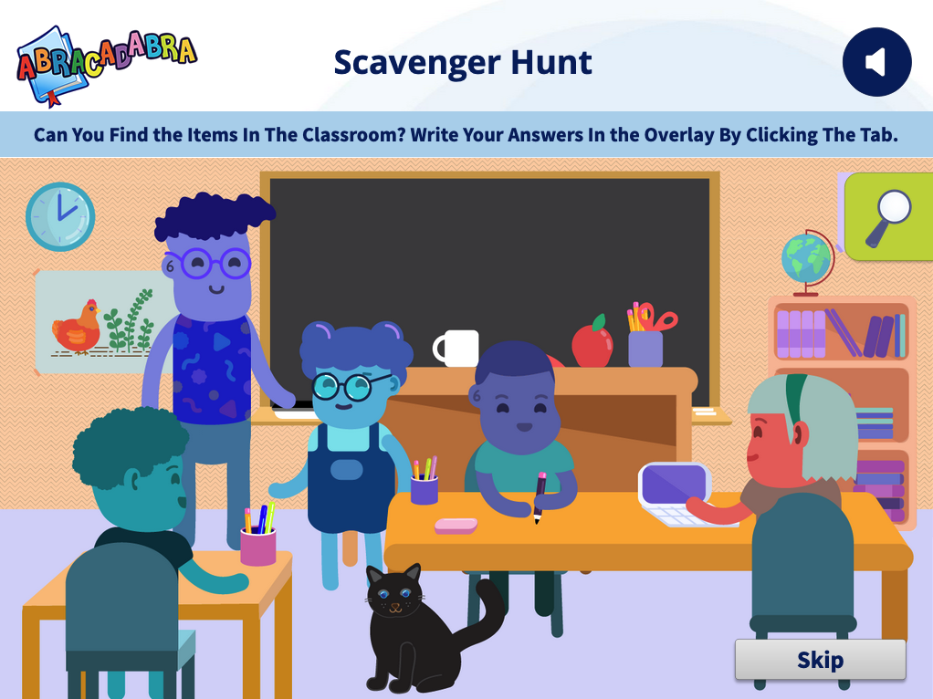
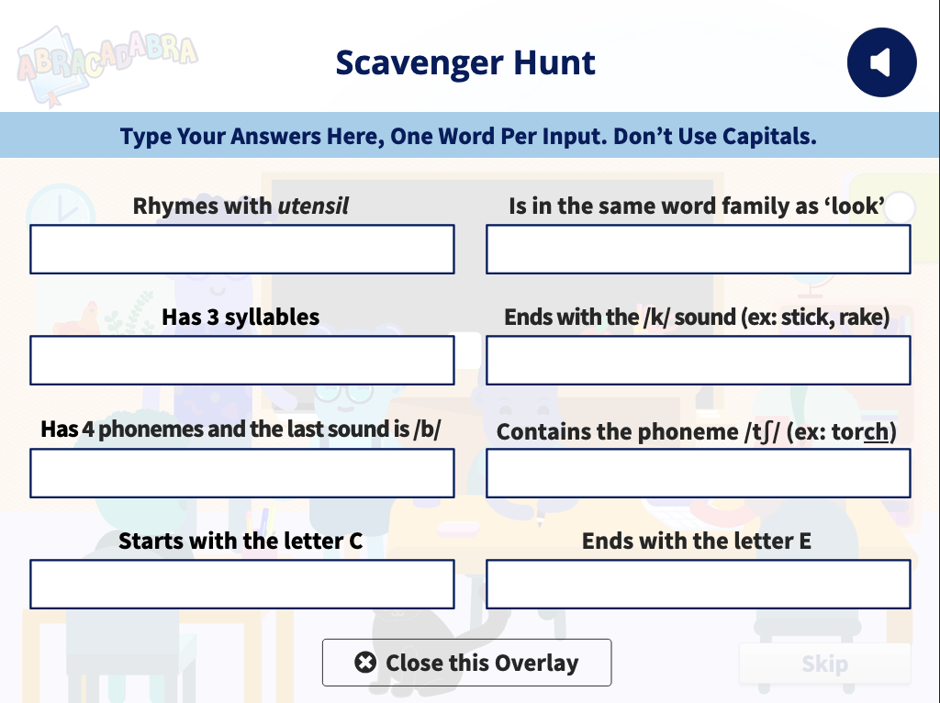
Warm-up Activity
Notes:
During the break, the facilitator should access the Scavenger Hunt activity in the Train the Trainer module: https://literacy.concordia.ca/tpd/mod_ttt/story.html
Table of contents > Assessment >Scavenger Hunt
They project this slide from the modules and solicit some teachers to answer the questions in the activity.

Slide 15
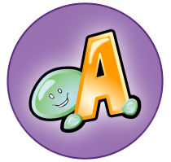
Alphabetics
Alphabetics is the ability to associate sounds with letters and use these sounds to create words. Research suggests children who do not have a solid foundation in these alphabetic principles are less skilled readers as they progress through school. Children need multiple opportunities, with a variety of phonetic and writing activities, to practice in order to build their fluency and comprehension skills.
Notes:
Day 2 of training can focus on Alphabetics, while day 3 can (briefly) cover the other pillars. Deeper dives/review can happen during the periodic support meetings, as needed.

Slide 16

















Alphabetics
The 17 Alphabetics activities can be split into 3 sub-skill areas
Pre-Alphabetic | Phonological Awareness | Phonics
Letter names and letter sounds. | Also includes Phonemic Awareness and deals with manipulating sounds in spoken language. | Connections between spoken words and written language.
Alphabet Song Animated Alphabet Letter Bingo Letter Sound Search Matching Sounds | Auditory Blending Auditory Segmenting Blending Train Rhyme Matching Same Phoneme Syllable Counting | Basic Decoding Same Word Word Changing Word Counting Word Families Word Matching

Slide 17
Pre-Alphabetics
Alphabet Song
Animated Alphabet
Letter Bingo
Letter Sound Search
Matching Sounds
Letter knowledge means much more than being able to recite the alphabet. Children also need to identify upper- and lower-case letters, match a letter sound to its symbol.

Slide 18
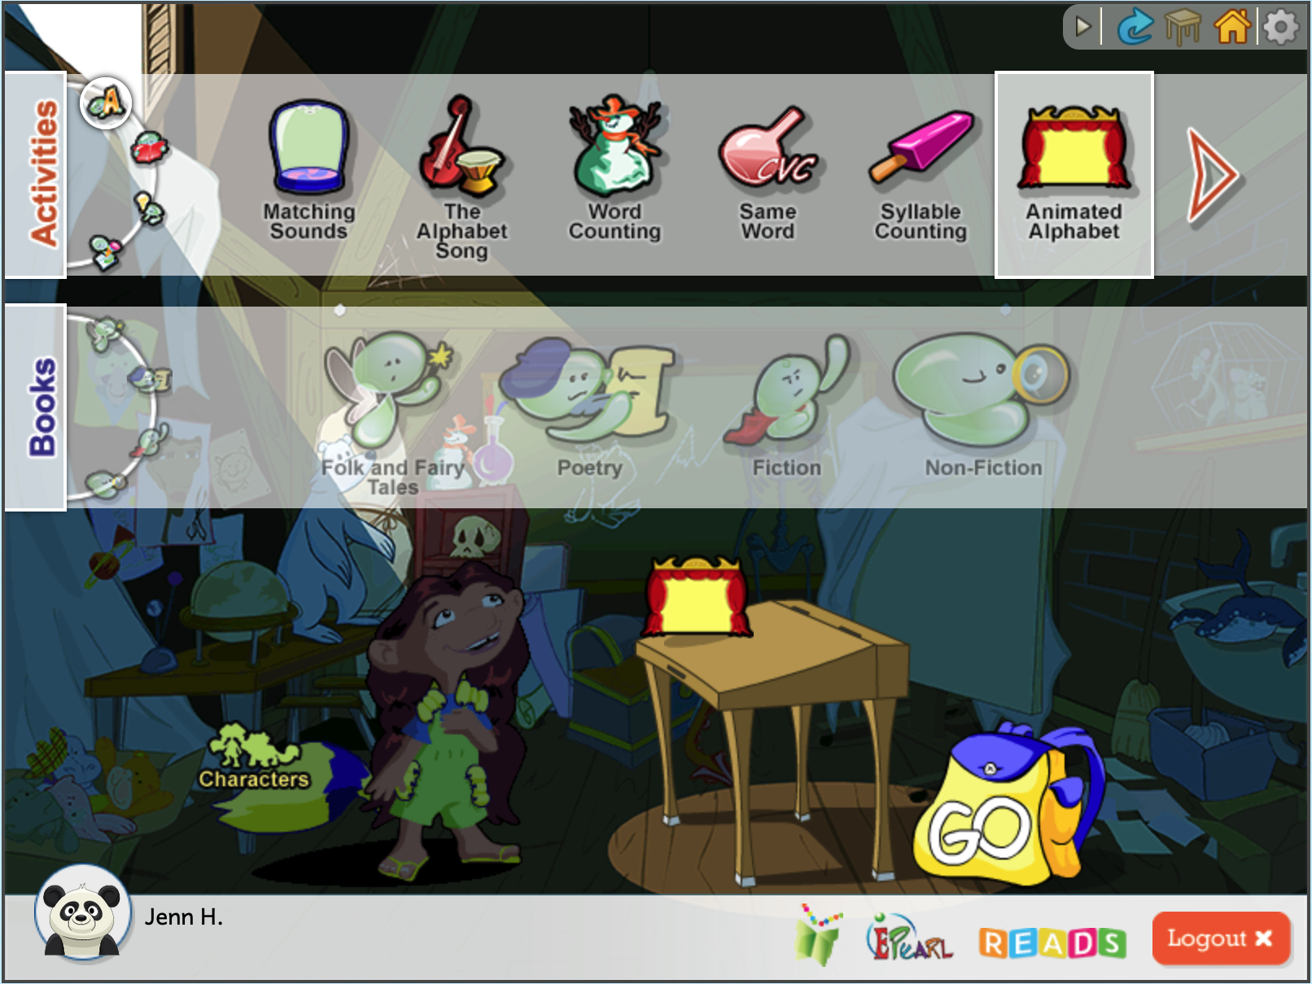
Pre-Alphabetics Demo
In the Sounds, Letters, and Words category.
Select the activity Animated Alphabet.
You can go directly to the activity by clicking Go.
Notice that the book genre section is greyed out and you cannot connect to a book. This means that this activity isn’t linked to a book.
Notes:
Demo this activity using a projector. Select a few of the letters and watch the animation (you can also ask the teachers to select a few letters). After a few examples, prompt teachers to share their initial thoughts about the activity and where/how it can fit in their curriculum.

Slide 19
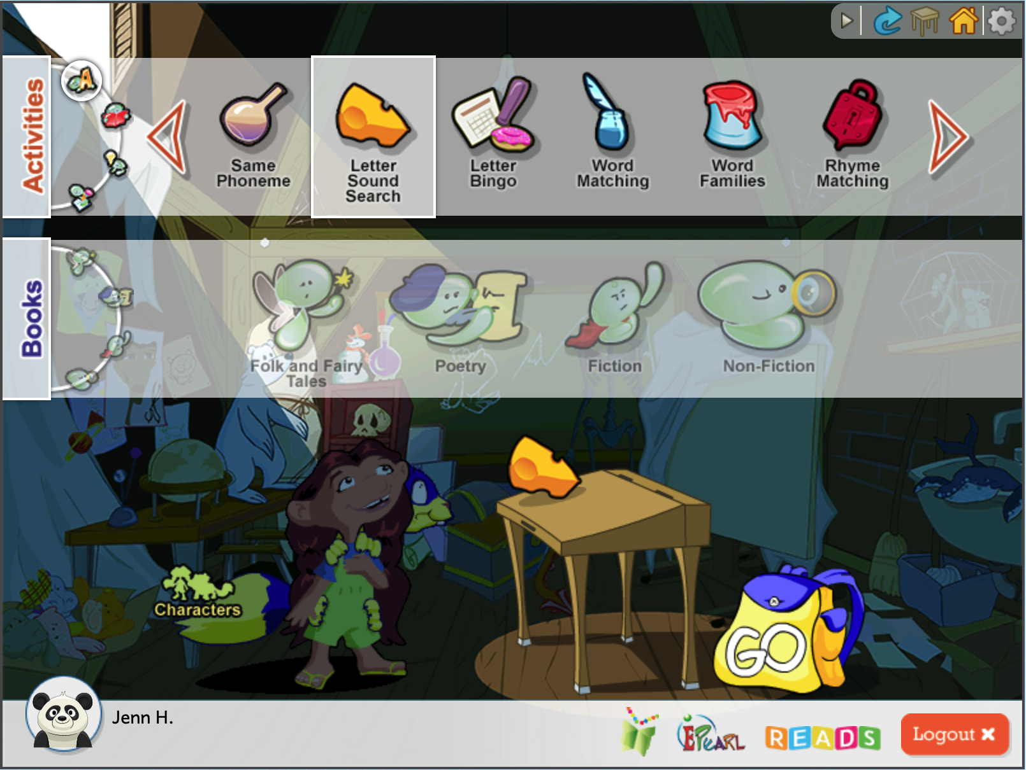

Now, You Try!
Select the Sounds, Letters, and Words category.
Use the next arrow button to see more activity options.
Select the activity Letter Sound Search.
Click on Go.
Notes:
Teacher Aid (Letter Sound Search walk-through): https://literacy.concordia.ca/tpd/mod_ttt/story_content/external_files/TPD-TA-LSSdirections-20210726.pdf

Slide 20
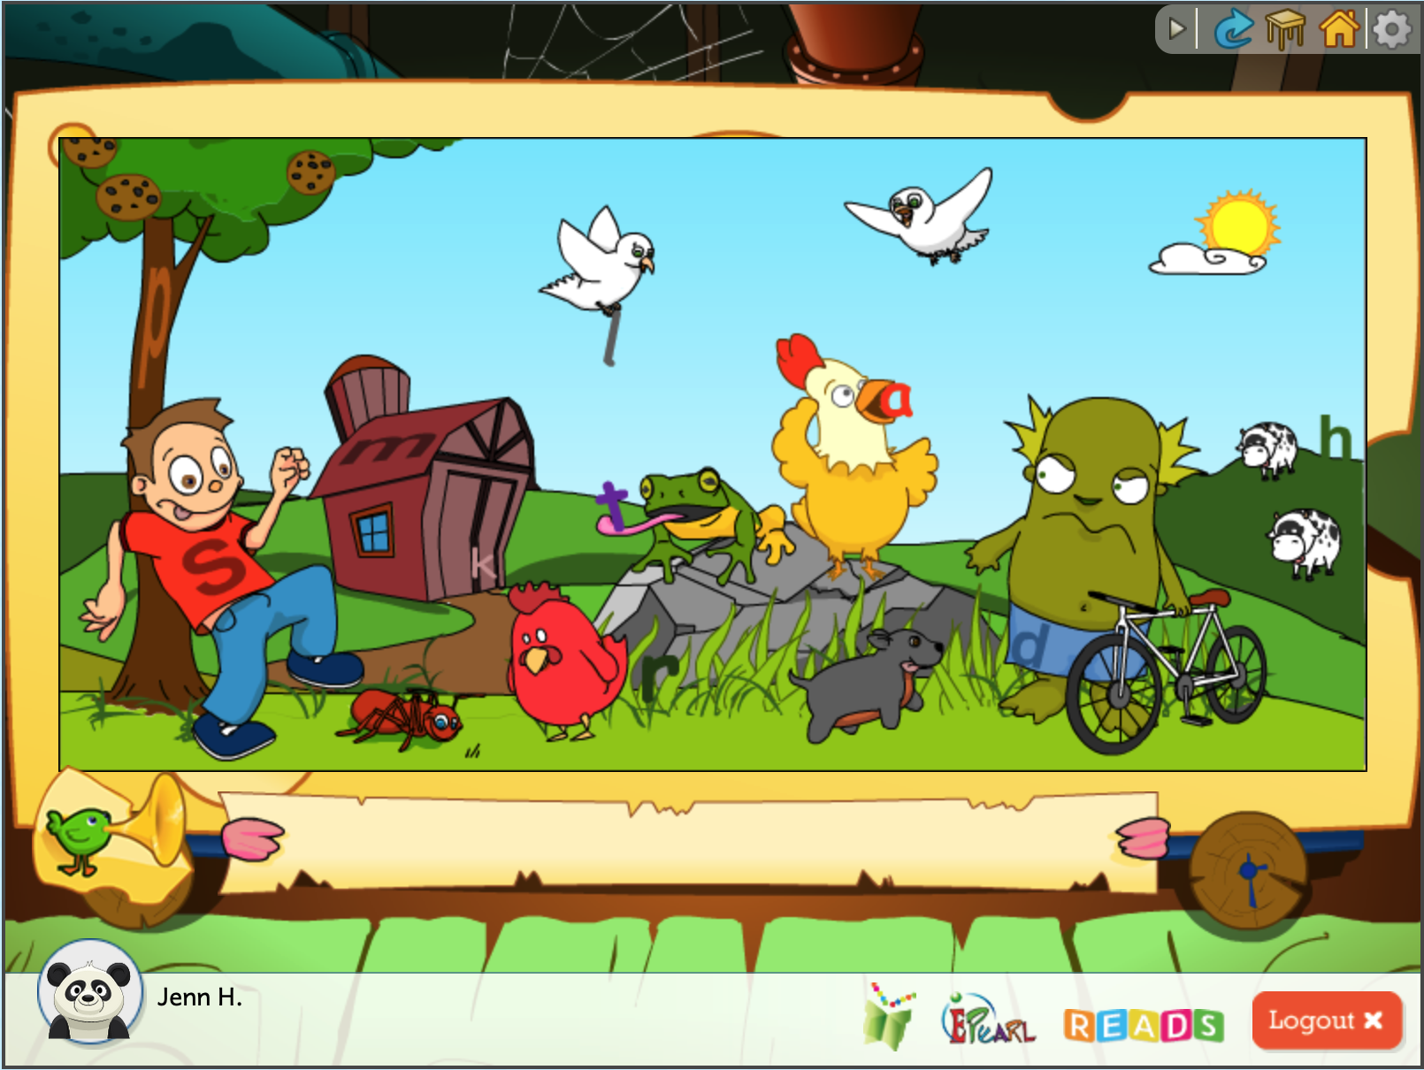


Pre-Alphabetics Exploration
Where might this activity fit in your curriculum?
What are some of the questions
that you have about Alphabetics?
What are the
areas that you
focus on while
teaching
Alphabetics for Grade 1?
Notes:
Once they have had a chance to explore this activity, you can ask them some follow up questions and gather their Initial impression of this activity.

Slide 21
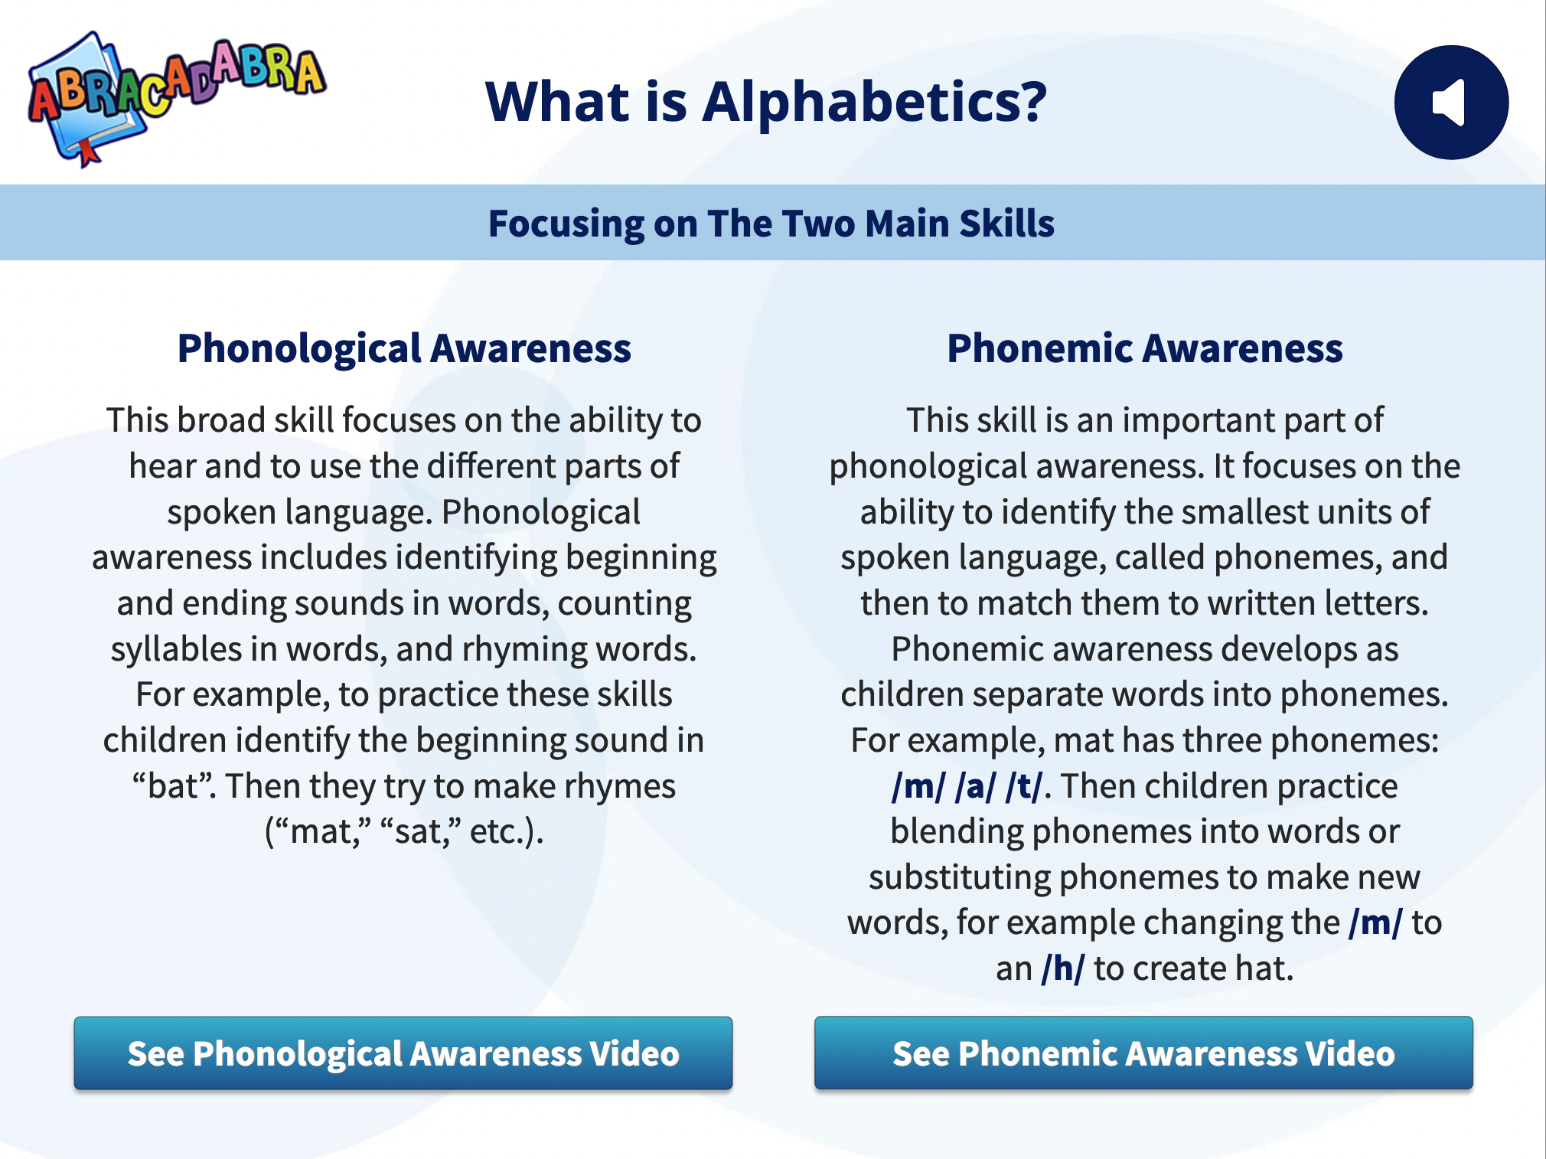
Review Key Concept from Day 1
For example:
Phonemic awareness activity: break down the word ‘Pat’ into /p/ /a/ /t/
Phonological awareness activity: break down the word ‘Pat’ into initial sound and rhyming unit (P – at)
In ABRA:
Phonemic awareness: Auditory Segmenting
Phonological awareness: Rhyme Matching
Notes:
The Alphabetics TPD module contains a glossary for these meta-language terms.
Go to the TPD module to watch the two videos about phonological awareness and phonemic awareness: https://literacy.concordia.ca/tpd/mod_alpha/story.html
Optional: You could do the TPD module “Count the phonemes” activity with them as a group.

Slide 22
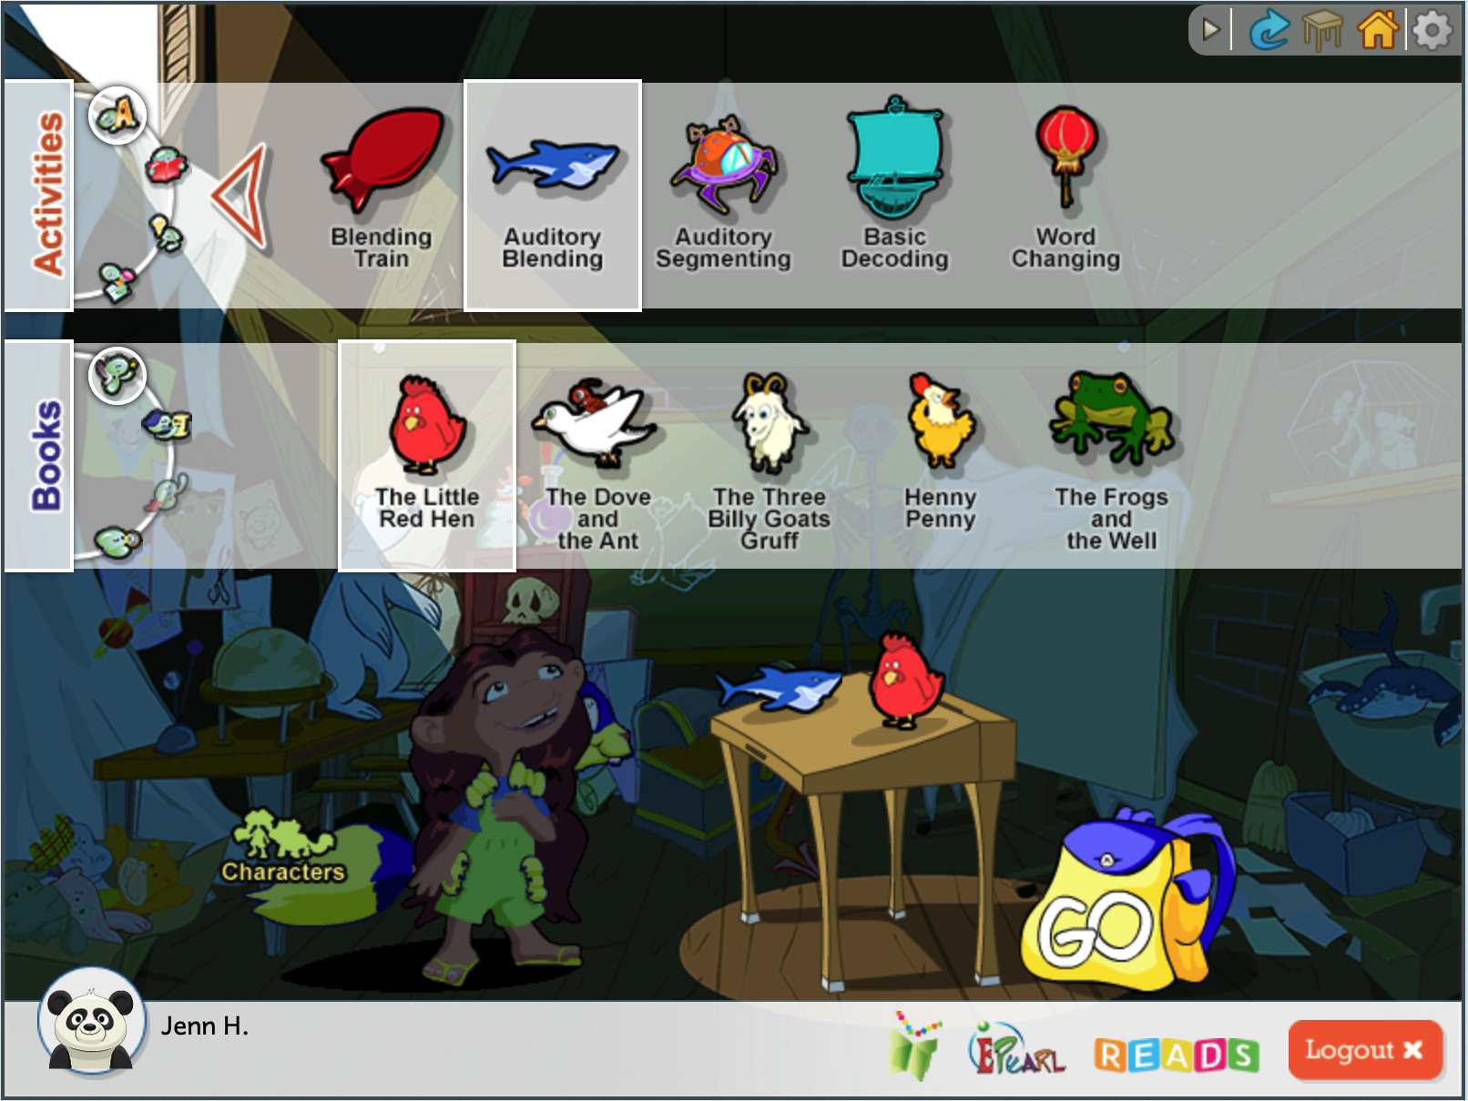
Phonemic Awareness Demo
Select the Sounds, Letters, and Words category.
Use the next arrow button twice to see more activity options.
Select the activity Auditory Blending.
Select a story genre in the second bar, then select a story.
Click on Go.
Notes:
Demo this activity using a projector. Then, prompt teachers to share their initial thoughts about the activity and where/how it can fit in their curriculum. You can also use this as an opportunity to check their understanding (ex: what is a phoneme? What is the difference between phonemic awareness and phonological awareness?)
If there is time, you can also demo one of the phonics activities, such as Word Families.

Slide 23
Curriculum Connections
Insert content that relates to the local curriculum and demonstrate how ABRA’s Alphabetics content is relevant to participants’ context
If you are using a document that has suggested activities that teachers can try in the upcoming weeks, review the document and ABRA activities, and hold a discussion (suggested prompts on next slide)

Slide 24
Curriculum Connections
Do you see these activities working for your classroom?
  Are you ready to try it, or do you have questions first (if so, what are they?)?
Identify some successes you foresee when taking learners through these activities.
What are the challenges you foresee?
  How can they be addressed or overcome?
  Is there an alternative activity that might work better? Why?
Generate one concrete example that you could use when talking to parents about Alphabetics.

Slide 25
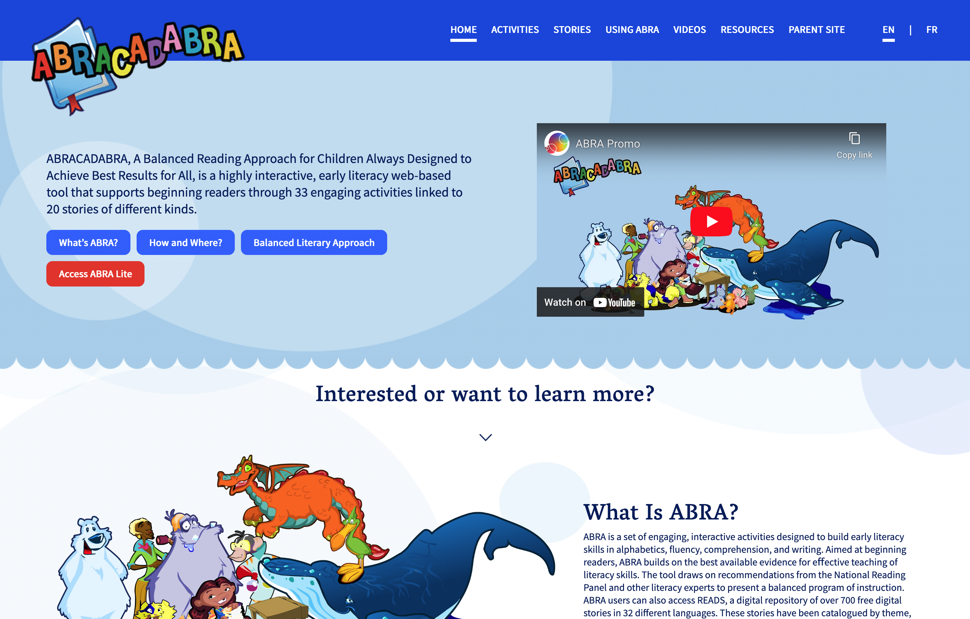
Teacher Resources
There are several teacher resources available to help you implement ABRA:
  Teacher Resources website
  ABRA’s assessment feature
  TPD modules
Notes:
1. Helps teachers plan an ABRA lesson
2. Supports teachers in finding the best activities and understanding its objectives
3. Provides implementation tips
4. Video support
Accessible on the web
https://literacy.concordia.ca/resources/abra/teacher/en/index.php

Slide 26

Questions?

Slide 27

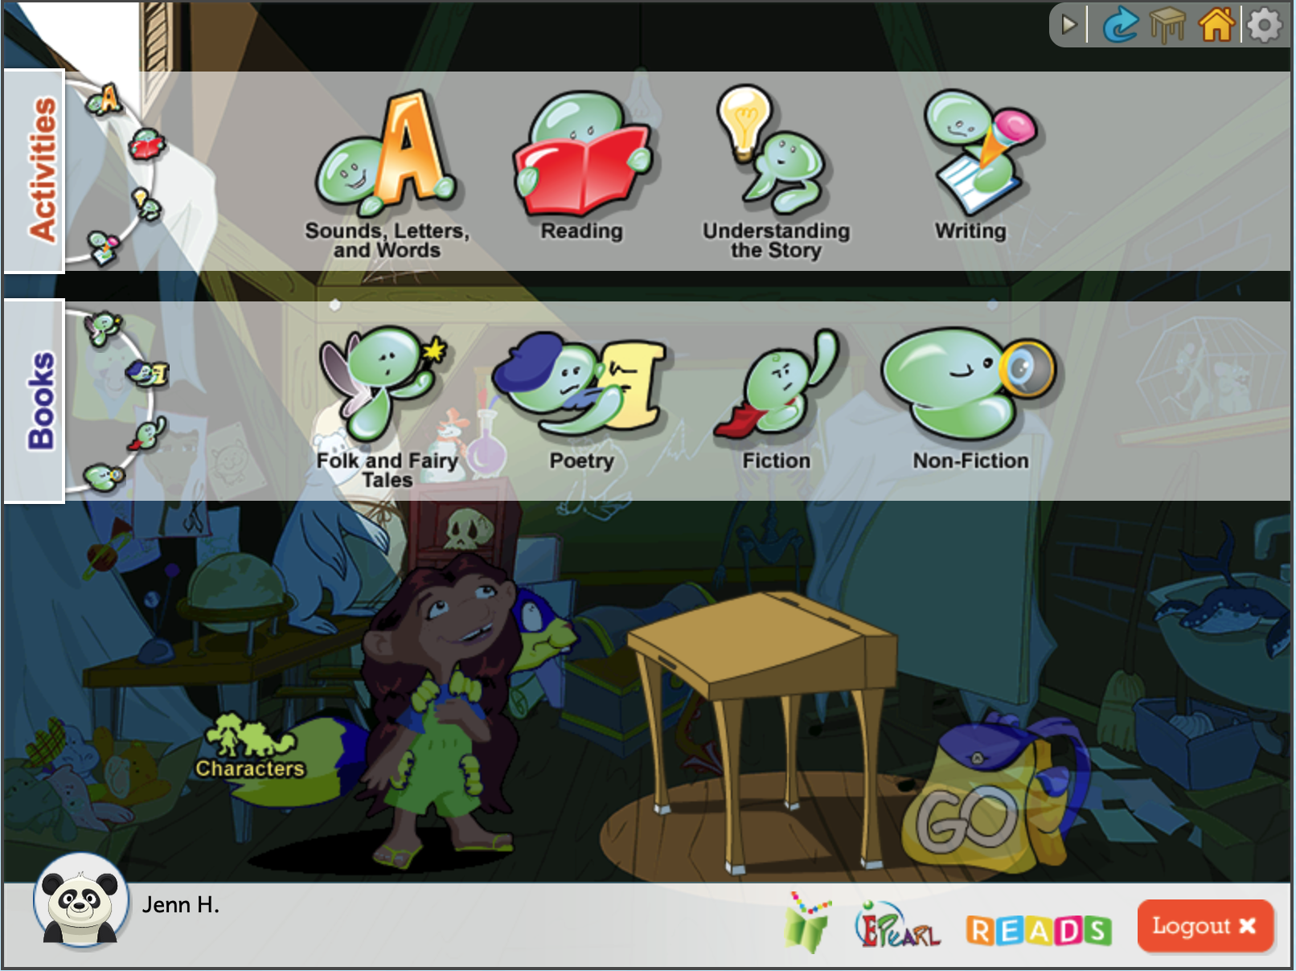


Looking Ahead – Day 3 Topics
Reading (Fluency): This skill refers to the ability to read a text out loud accurately, at the proper speed, and with expression.
Understanding the Story (Comprehension): This skill targets reading for meaning, which is the goal of learning how to read. In ABRA, this category also covers vocabulary, which refers to the words used to communicate successfully.
Writing: This skill addresses the use of letters and words to create sentences and texts for others to read.

