Slide 1
Teaching Early Literacy with the Learning Toolkit+
A Teacher Professional Development Course
Day 1
Notes:
Legend for highlighted text in this document:
Yellow highlights: for facilitators to adjust.
Green highlights: if relevant, otherwise could be deleted. Maybe require facilitators to adjust if kept.

Slide 2
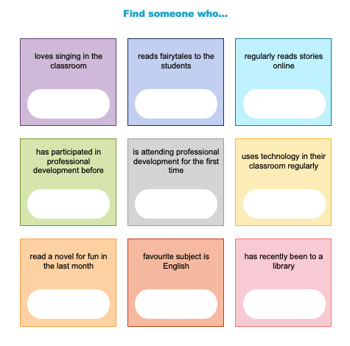
Icebreaker
Introductions – Insert activity (ex: Human Bingo, Name Game, One Word at a Time)
Notes:
If culturally relevant, could add a slide for the national anthem prior to any introduction/icebreaker activities.
Common icebreakers suggestions:
Human Bingo: Each participant is given a bingo card with descriptions. When they find someone that matches the description, they add their name to the card. Two sample worksheets were created with descriptions that relate to literacy, English, ICT or TPD.
Name Game: A participant introduces themselves and shares one fact about themselves (favourite colour, how many kids they have, what they like to do for fun, etc.). The person next to them repeats their name and fact and then introduces themselves and says one fact about themselves. This continues – the last person will have to try to say everyone’s name and fact before introducing themselves. It’s OK if someone gets stuck though!
Possible variations: only say their name (easier for large groups), or participants don’t have to repeat previous people’s names, or they say something they like that starts with the same letter as their name, or they focus on something related to literacy like they say their name and then their favourite book.
One Word at a Time: Participants should be arranged in some sort of order (circle, rows). Give them a topic to help guide the activity. Participants work together to create a sentence, but each person takes a turn to say one word only.
If you would like participants to do a pre-test, allow some time to ensure all have completed it before you start introducing the content of training.

Slide 3
Agenda – Day 1
Introduction to the program
  Objectives
  Schedule
  Expectations
  Learning in a blended environment (this might have been covered in the optional ICT workshop prior to TPD)
Learning Sciences
  Key Skills
Introduction to the online TPD modules
Meetings and support
Graduation Criteria

Slide 4
Agenda – Looking Ahead
Day 2
Day 3
Overview of the LTK+
Overview of ABRA
Alphabetics
Teacher Resources
Fluency
Comprehension
Writing
Curriculum connections
ABRA assessment feature
Overview of READS

Slide 5
Agenda – Looking Ahead
Day 2
Day 3
Overview of the LTK+
Overview of ABRA
  How it was designed
  4 key skills
  Log in and explore
  Resources for this cohort
Alphabetics
  Review key sub-skills
  Explore ABRA
  Curriculum connections
Review Alphabetics
Teacher Resources
Meetings and support
Graduation
Notes:
A possible alternative schedule, would be to cover this content over 5 days, but spread out the last two days to avoid overwhelming* participants (3-days + 1 day + 1 day). This slide and the next slide are suggestions in how you can reorganize the content of the PP into a new 5-day schedule instead.
* If you keep to the suggested 3-day schedule but worry that teachers won’t be able to absorb and apply all content covered, you review or provide a deeper look at relevant sections during the follow-up meetings.

Slide 6
Agenda – Looking Ahead
Day 4 – Insert Date (~2-4 weeks later)
Day 5 – Insert Date (~2-4 weeks later)
Review
Fluency
  Key sub-skills
  Explore ABRA
  Curriculum connections
Overview of READS
  Exploration
  Curriculum connections
Review
Comprehension
  Key sub-skills
  Explore ABRA
  Curriculum connections
ABRA assessment feature
  Importance of logging in and out

Slide 7
Objectives
Skills you’ll develop:
  Acquire proficiency with the ABRA software: login and out, navigation, foundational literacy skill areas, connections to country curriculum, implementation in classrooms;
  Familiarity with READS: navigation, how it can be used to support literacy development, connections to country curriculum, implementation in classrooms;
  Explore targeted content from the TPD modules: build competency in key literacy skills;
  Establish a community of practice.
Notes:
(optional): If there is something you would like to learn from the participants, you can also include it on this slide (or add another slide)

Slide 8
Schedule and Deliverables
Insert meeting dates, submission due dates, etc.
Process for submissions
  Provide links (ex: google forms) or the plan for how and when teachers will be given them (ex: listed in an agenda document, shared in WhatsApp on Mondays, etc.).
  File name conventions that you’d like them to use.
  Preference to have 1 file/submission.
    Useful apps, like Genius Scan, can use a phone’s camera to create a PDF of a physical copy of a document. Multiple pages can easily be combined into one file.
If relevant, could also talk about process for setting up individualized dates (observations, support, etc.) or other school-based organizational needs.
Notes:
An example of file naming conventions: <type of submission> <lastname> Example: Reflection1_Acharya

Slide 9
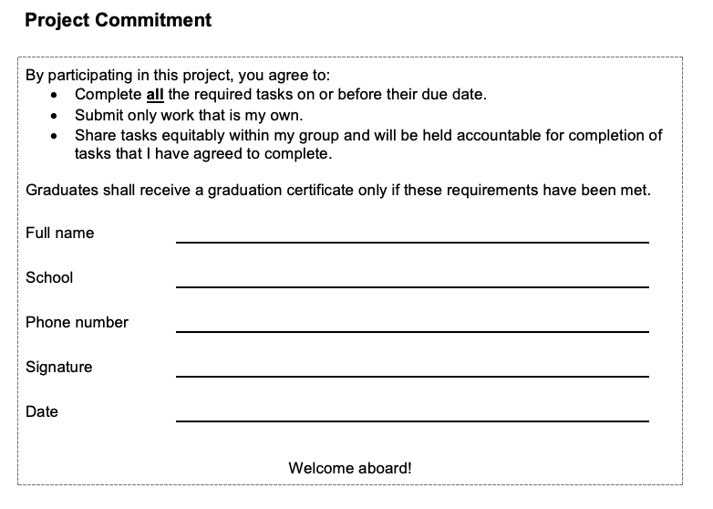
Expectations
Specific info for project/cohort
Purpose of the Project Commitment form
Notes:
Could go over the doc with them and ask them to sign/collect them during the training session. Might be easier to ensure everyone submits in a timely manner, and the facilitator could review each doc during/after day 1 training and if there is any issues (example missing info on form) or missing forms they follow up on day 2. Or, if teacher would like to bring home for closer read after day 1 and bring back on day 2, the facilitator would still have time to check them and follow up on any issues during day 3. Reduce the amount of teachers they might have to run after later on.

Slide 10
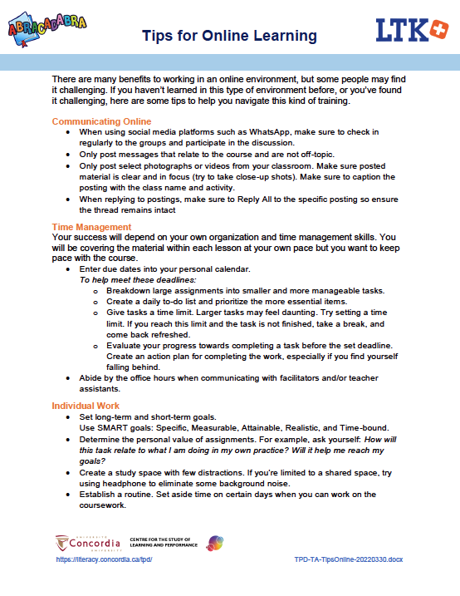
Learning in a Blended Environment
Mobile Data Management/accessing data bundles
Accessing platforms (Zoom, Google forms, etc.)
  How we’ll use WhatsApp (ex: general and announcements groups, etc.)
  Weekly schedule to help establish routine
Tips for online learning
Notes:
The following videos were prepared for Kenya in (year?). If relevant to your context, they can be used at this stage with your participants.
Data bundles management:
Attending zoom sessions using a phone:
Tips for online learning: can provide handout (pictured on right)

Slide 11


Coffee/Tea Break?

Slide 12
Global Literacy Crisis
Before the pandemic:
  258 million children and youth were not in school
  483 million children of primary and lower secondary school age had not reached minimum educational levels after years spent in school.
Children from rural and remote communities, nomadic and displaced students, those with learning difficulties, and in many cases girls, are struggling, falling behind and dropping out.

Slide 13
Global Literacy Crisis
What does the learning crisis tell us?
  There is a critical need for effective instructional approaches that support children’s early literacy development, and engagement in their education, before grade three and prevent their risk of educational failure.
How do we provide an effective approach, especially those most at risk?
Engage in evidence-base practice.
Notes:
You could show this video: https://youtu.be/yRhWifhimYI

Slide 14

Evidence-Based Practice
Scientific evidence
Critical evaluation
Measure impact
Seek effective ways to improve
Informed decisions
  Individual impact (ex: teacher designs lesson plan)
  Large-scale impact (ex: policy)
Notes:
Existing knowledge: prior research on topic, subject matter experts, stakeholders. Systemic review/meta analysis.
Qualitative vs quantitative research.
Critical evaluation of existing evidence: is it replicable? Context-specific? Generalizable? valid measures?
Critical evaluation of a treatment: clear guidelines? is it having the expected impact? Statistically significant impact? Unforeseen impact? Length of exposure? 3rd party evaluations?

Slide 15
Evidence-Based Practice: LTK+
LTK+ is evidence-based and evidence-proven.
Creation of a multi-disciplinary LTK team. Regular meetings throughout the design and implementation phases.
Pilot phases: Tested new innovations with a small group, and collected data (user feedback, pre/post text gains, observations, anecdotes, etc.). Took what was learned to improve the design, fill gaps, and plan for larger scale study.
Multi-year studies to evaluate benefits for students and teachers.
Published papers in scholarly journals.
External organizations have also studied LTK+ and reported learning gains.
Iterative process: What is learned from the data collected, impacted our work going forward.

Slide 16
National Reading Panel
Spent 2 years reviewing research on children’s reading achievement, and instructional actions that led to higher achievement
5 essential areas of instruction for reading proficiency:
  Phonemic awareness
  Phonics
  Fluency
  Vocabulary
  Comprehension
Evidence-based practice: Why is this research important? It informs us how the human brain learns to read, and teachers can utilize this information to implement effective instruction strategies to reach their learners - including the ones most at risk.

Slide 17
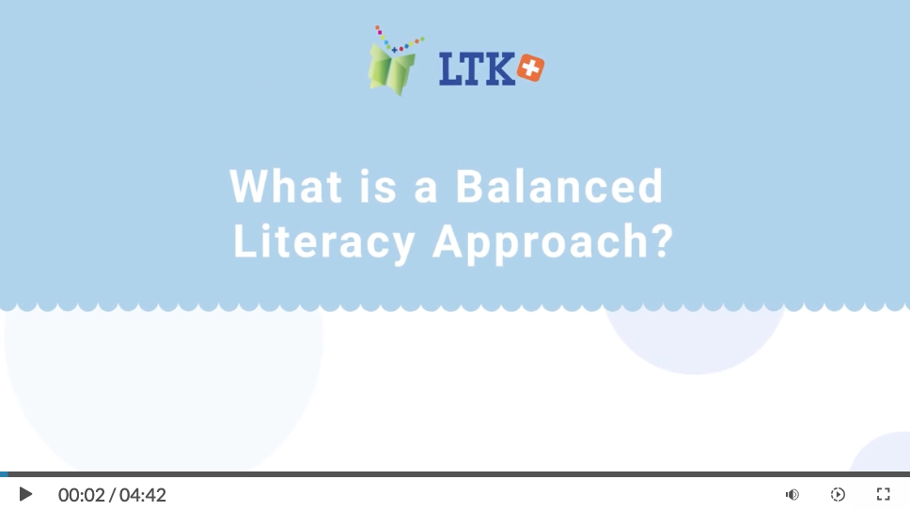
A Balanced Literacy Approach
Notes:
Show the video from the Getting Started with ABRACADABRA module: https://literacy.concordia.ca/tpd/mod_started/story.html

Slide 18
Foundational Literacy Skills
NRP identified five key components for developing strong reading skills, but what do they mean and how can we work on those skills?
Broad Literacy Skill | Sub-skills
Alphabetics Sounds, letters and words | letter recognition, letter sounds, word awareness, syllables, onset and rime, phonemic awareness, blending, segmenting, phoneme manipulation, phonics, decoding, word recognition, etc.
Fluency Reading | Accuracy, speed, expression, sight recognition
Comprehension Understanding the story | Comprehension monitoring, prediction, sequencing, summarizing, vocabulary, critical thinking, etc.
Writing | Letter formation, pencil grip, grammar, spelling, composition, typing, etc.
Notes:
Let’s situate NRP’s essential areas in a larger literacy framework of foundational skills. Those 5 essential skills are important but there are building blocks that are needed before you can jump into them. Also, those skills are complex, so it might help to break it down into smaller components.

Slide 19
Define Key Terms
NRP’s report grouped the first two essential skills, phonemic awareness and phonics, into a category called alphabetics. What do these three terms mean?
Phonemic Awareness
Phonics
Alphabetics

Slide 20
Define Key Terms
Phonemic Awareness
  identifying and manipulating the smallest units of spoken language (sounds).
Phonemes
  individual sounds of language.
Phonemic Awareness
Phonemic Awareness
Phonics
Alphabetics
Notes:
Ask teachers if they know what phonemic awareness is. What is a phoneme?
Before moving on to phonics, maybe situate phonemic awareness in phonological awareness as well.

Slide 21
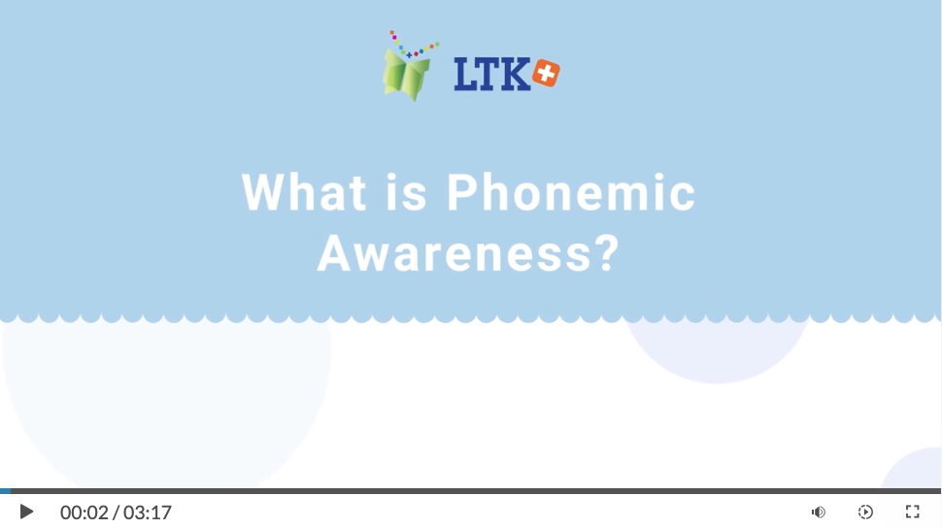
What is Phonemic Awareness?
Notes:
Show the video from the Alphabetics module: https://literacy.concordia.ca/tpd/mod_alpha/story.html
Use Table of Contents: Alphabetics > What is Phonemic Awareness?

Slide 22
What is Phonemic Awareness?
The cat is fat.
Th/e /c/a/t i/s /f/a/t
How would you pronounce these words one syllable at a time?
go, cup, red, van, flag,
look, sheep, swing
Segmenting Break a word down into individual parts.
What skill did you demonstrate in this activity?
What skill did you demonstrate in this activity?
Segmenting Break a word down into individual parts.
What skill would it be if you did the reverse? Hint: it was mentioned in the video
Blending Combining individual sounds to make a word.
Segmenting Break a word down into individual parts.
What skill would it be if you did the reverse? Hint: it was mentioned in the video
Notes:
The video provided an example of saying a sentence one phoneme at a time: Th/e /c/a/t i/s /f/a/t.
Practice with a few other words/sentences.
Usually start with one syllable CVC words, like cat and fat in the example above. Some other example: dog, fan, rug, sit, ten.
Also, usually begin by having children focus on the first sound in words. Remind them that it’s what you hear, not spelling.
Second row is a few harder examples - use these to demonstrate that phones are not tied to letters.
Look has 4 letters but 3 phonemes: l/oo/k ( /l/ /ʊ/ /k/ )
Sheep has 5 letters but 3 phonemes: sh/ee/p ( /ʃ/ /iː/ /p/ )
Swing has 5 letters but 4 phonemes: s/w/i/ng ( /s/ /w/ /ee/ /ng/ )

Slide 23

Teaching Blending & Segmenting
Phoneme isolation: Identify beginning, medial and ending sounds
Model the process.
Introduce children to a classroom puppet.
  To practice blending, the puppet can talk to them by saying a word “one sound at a time” and children must guess what the word is.
  To practice segmenting, ask children to talk to the puppet “one sound at a time”.
Notes:
Teach children how to manipulate sounds through segmenting, blending and substitution.
Usually start with one syllable CVC words, like cat and fat. Some other example: dog, fan, rug, sit, ten.
Also, usually begin by having children focus on the first sound in words. Remind them that it’s what you hear, not spelling.
Once children can identify the beginning, medial and ending sounds, you can practice orally blending and segmenting words with them.
Should we mention other phoneme manipulation activities now? ABRA does this (mostly substitution) more in phonics activities but it doesn’t need to be tied to the written word (phonics) and can be done orally.
Phoneme addition: it → sit
Phoneme deletion: sit → it
Phoneme substitution: sit → hit (tackled in ABRA’s word families and word changing activities)
Also, we don’t currently go into explaining some of this in our modules (and maybe we should – after KIX we have talked about editing Alphabetics), so I’m not sure if there are other phoneme skills/activities we should define here or in Day 2 training (when covering Alphabetics). We’re covering the key skills, so saying more might not be needed. But here are more just in case:
Phoneme identity: same sound in different words (sit, sun, sand)
Phoneme categorization: which word doesn’t belong in a set/has the odd sound (sit, sad, car) – I don’t think we cover this in ABRA but we could make a few worksheets to fill the gap

Slide 24

Define Key Terms
Phonemic Awareness
  identifying and manipulating the smallest units of spoken language (sounds).
Phonological Awareness
  noticing and working with the sounds in spoken language.
Phonemic Awareness
Phonemic Awareness
Onset and Rime
Syllables
Words
Notes:
Situate phonemic awareness as a subskill of phonological awareness.
Maybe start by summing up how phonemic awareness instruction helps with reading, but then take a step back, like: Developing phonemic awareness improves students’ ability to read and comprehend words. Developing a skill like segmenting words into phonemes can also help them spelling. While there are some exceptions, like we saw in the activity we just did, phonemic awareness skills help children relate letters and sounds in predictable ways. Teaching this skill is more effective when also tied to letters of the alphabet, which is part of phonics that we will look at shortly. But if at this point you’re thinking ‘this isn’t how I normally tackle identifying sounds in words’, or feeling like there is more to it, or maybe you’re wondering whether your students have the skills necessary to start, then it might help to situation phonemic awareness as just one part of a boarder category called phonological awareness.
Then you can prompt teachers to define phonological awareness if they can and then briefly cover each of the levels (more details can be covered in Day 2).
Word level: word awareness, sentence segmentation (The / cat / is / fat =4 words), rhyming (cat, fat, hat, bat, mat), alliteration (Maria made marbles and magnets).
Syllable level: counting syllables
Onset and rime level: onset prior to vowel and rime vowel and afterwards (ex: ”cat” the c is onset and at is rime)

Slide 25
Define Key Terms
Phonics
  building connections between spoken words and written language.
  Phonics involves learning to use letter sounds to read words by matching the sounds of letters (phonemes) to letters (graphemes). Phonics helps children to understand how print works.
Phonemic Awareness
Phonics
Alphabetics
Notes:
Ask teachers if they know what phonics is.

Slide 26
Define Key Terms
Alphabetics
  the ability to recognize the different sounds in a spoken language and then match those sounds to written letters and words. Alphabetic skills include: letter knowledge, phonological and phonemic awareness, and phonics.
Phonemic Awareness
Phonics
Alphabetics
Notes:
Define Alphabetics. Umbrella term that captures all the skills we just mentioned and more. Mention that it is a term used in ABRA training – they will see it again when we look at the TPD modules later today.

Slide 27



Lunch Break

Slide 28
Activity
Jabberwocky
By Lewis Carroll
’Twas brillig, and the slithy toves
Did gyre and gimble in the wabe:
All mimsy were the borogoves,
And the mome raths outgrabe.
Notes:
“What’s happening here?” Most will not know what’s happening. That’s ok.
Ask the following questions:
What are the creatures? (What were the toves like? How were the borogoves like?)
What are they doing?
This activity shows how you can scaffold activities, even with real words. Notice how I helped you work your way through, that is called scaffolding.
You knew you didn’t understand, what did you try to do? Think about how you would model this in your classroom. If they are reading a book with a word that they know their learners don’t know, they can stop and think with their children as they read as a class.

Slide 29
Define Key Terms
NRP had three more essential categories for reading proficiency.
These will be covered in more depth during our follow-up training, but let’s define them now to understand how they contribute to children’s reading achievement.
Fluency
Vocabulary
Comprehension

Slide 30
Define Key Terms
Fluency
  the ability to quickly recognize words and their meaning. Fluent readers are able to read with accuracy, speed, and expression.
This skill takes time to develop.
Fluent readers can read aloud as if they’re speaking.
A child’s skills might fluctuate depending on their familiarity with the words.
Fluency
Vocabulary
Comprehension
Notes:
Ask teachers if they know what fluency is.
Other things to mention:
Accuracy – They have been doing this in Alphabetics. They must read accurately before they can read fluently. If the kids can’t read accurately, they will have to go back to developing their Alphabetics skills.
Speed at the cost of accuracy is not recommended.
Expression can be used to convey meaning.
Why is it important?
Non-fluent readers focus their energy on decoding individual words and might not be able to connect the words in a sentence and get the overall idea of the text. Fluent readers can devote their focus to making these connections and calling on their prior knowledge. In other words, they can devote their efforts on comprehension skills.
Pause and prompt teachers to think about what kind of activities they already do that help their students build this skill?\. Some things they might say (or the facilitator can prompt them on):
High frequency words/sight words
Modeling (accuracy, speed and expression) – maybe using strategies like echo reading or student-adult reading
Other reading strategies: audio assisted, partner reading, older students, etc.
Repetition of texts
Record students reading. Use to evaluate or compare to a fluency reader, or to track growth over the course of the year.

Slide 31
Define Key Terms
Vocabulary
  the words we use to communicate successfully. An individual’s vocabulary can help their ability to comprehend what they hear or read.
Direct instruction should focus on two elements: teaching the meanings of specific words and giving children strategies for learning new words.
Fluency
Vocabulary
Comprehension
Notes:
Oral vocabulary refers to the words we recognize and use when talking and listening.
Reading vocabulary refers to words we understand in a written text.

Slide 32
Define Key Terms
Comprehension
  the ability to understand information within a text.
Fluency
Vocabulary
Comprehension

Slide 33

Questions?

Slide 34
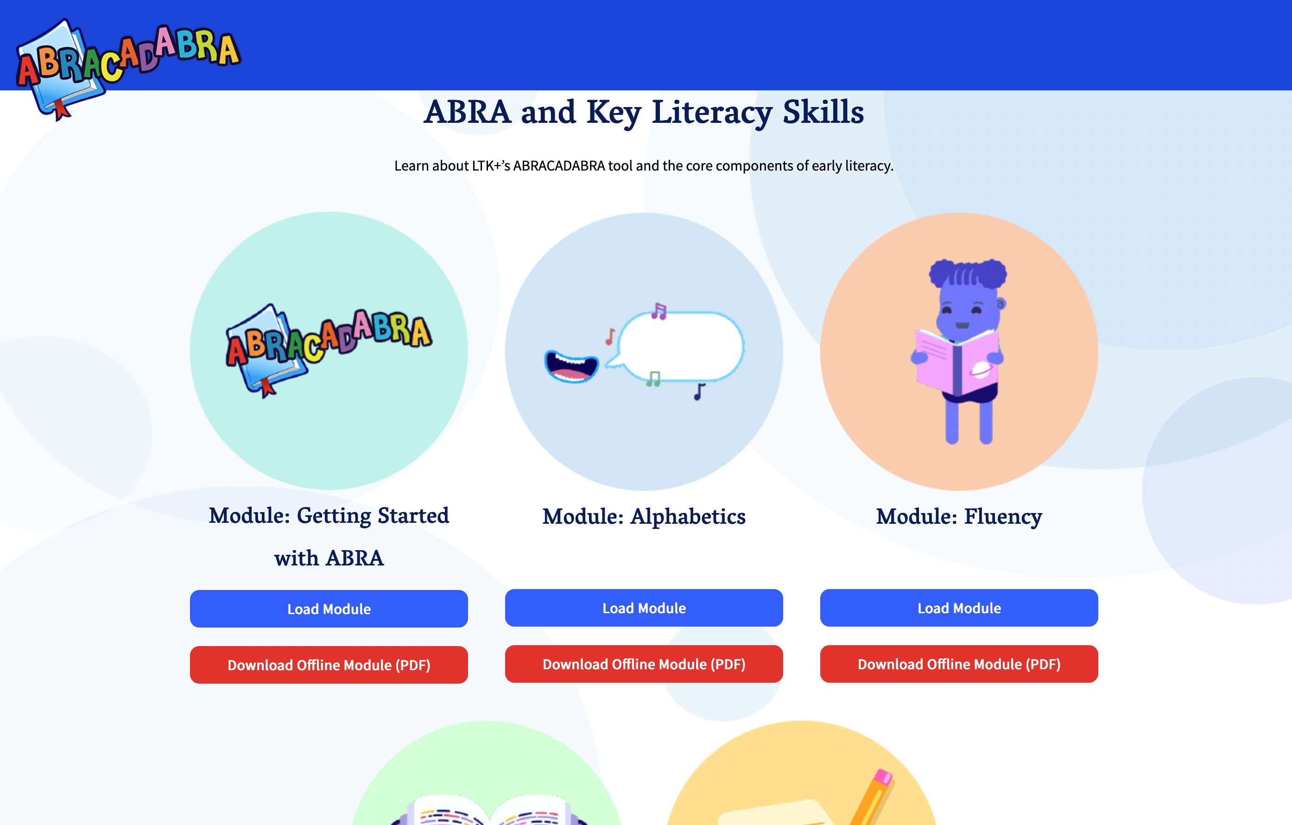
TPD Modules
Freely accessible online, the TPD modules cover:
Broad literacy skills
Other LTK+ tools and features
Teaching strategies
https://literacy.concordia.ca/tpd/

Slide 35
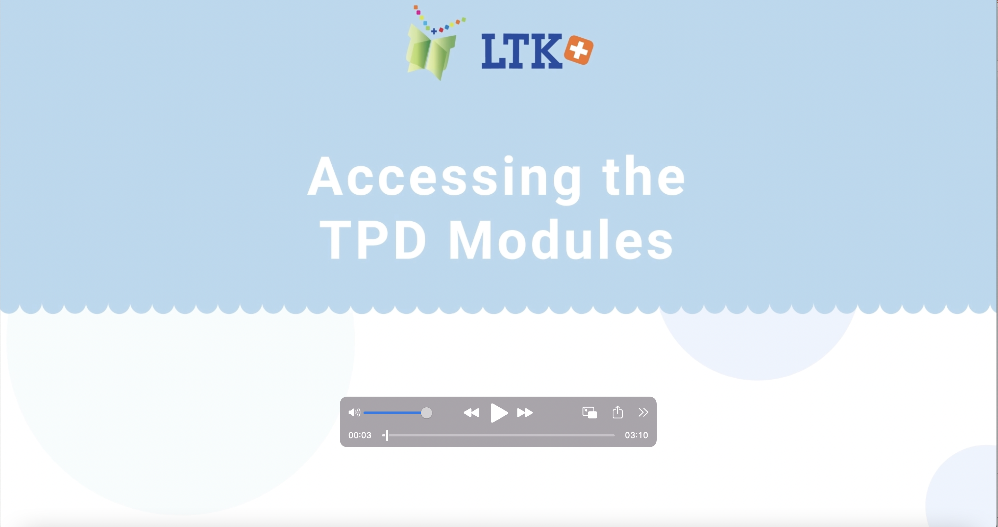
How to Access the TPD Modules
Notes:
Watch the video: https://www.youtube.com/watch?v=ZlcY7hh_nTI

Slide 36
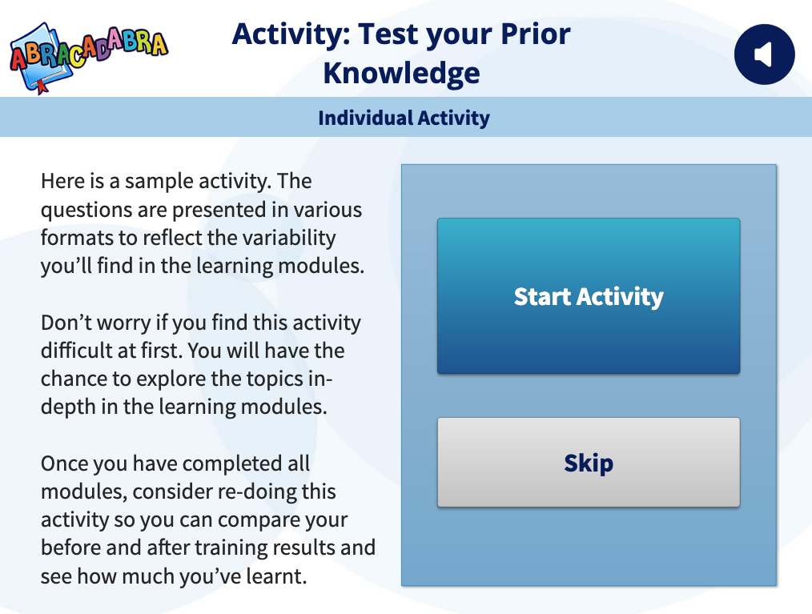
Demo the TPD Modules
Find Module: Introduction.
Show the two access options (interactive vs. pdf), then press on the Load Module button.
Point out some standard support features (audio button, glossary, TOC).
Start going through the content of the module.
Notes:
When you point out the glossary feature, you can also reinforce that many of the terms covered today will be part of the glossaries (this varies by module – if the term if relevant/within that module).
Demo the introduction module: https://literacy.concordia.ca/tpd/mod_intro/story.html
You can do the knowledge check activity together as that covers all skills. Could be a review of some content covered today and a pre-test for Day 2 & 3 topics.

Slide 37
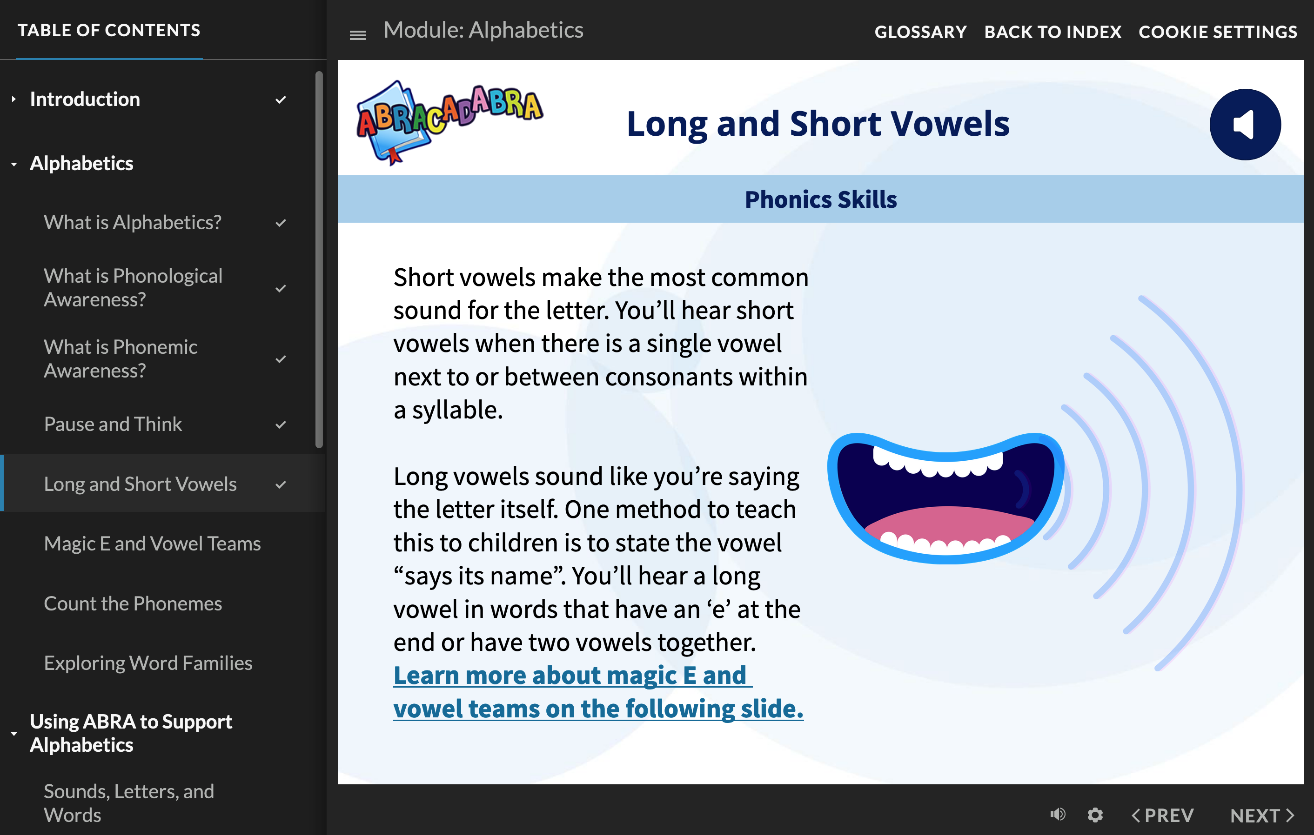
Explore the TPD Modules
Go to https://literacy.concordia.ca/tpd/mod_alpha/story.html
Find Module: Alphabetics, and press on the Load Module button.
Start going through the content of the module (introduction and skill sections)
  Watch the video
  Review skill slides
  Try the knowledge check activities

Slide 38
Meetings & Other Support
Monthly Meetings
  Opportunity to share experiences and learn from each other (COP)
  Topics of interest: review or deeper look at sub-skills or features of the tool. Prior to the meeting, you will be asked to review content from different modules. During the meeting (or prior to?), you will be asked to complete a short scavenger hunt activity that relates to the content of these modules and/or ABRA activities.
  Ask questions and provide feedback.
  Review and discuss curriculum doc or lessons/assignments.
WhatsApp: keep in touch with the group in between the meetings. Share your progress, ask for advice, etc.
School-based support

Slide 39

Graduation Criteria
Certificates will be given to all those who have completed all the requirements.
Honours Graduate:
  Attendance and participation at in-person sessions
  Evidence of ABRA and READS implementation
  Submit exceptional work on time
  Quality of feedback
  Quality of peer support
Graduation date: TBD

Slide 40
Reminder: Deliverables
Is there anything they need to submit? Permission form, completed pre-test, scavenger hunt, reflection, etc.?

Slide 41

Questions?

