Slide 1

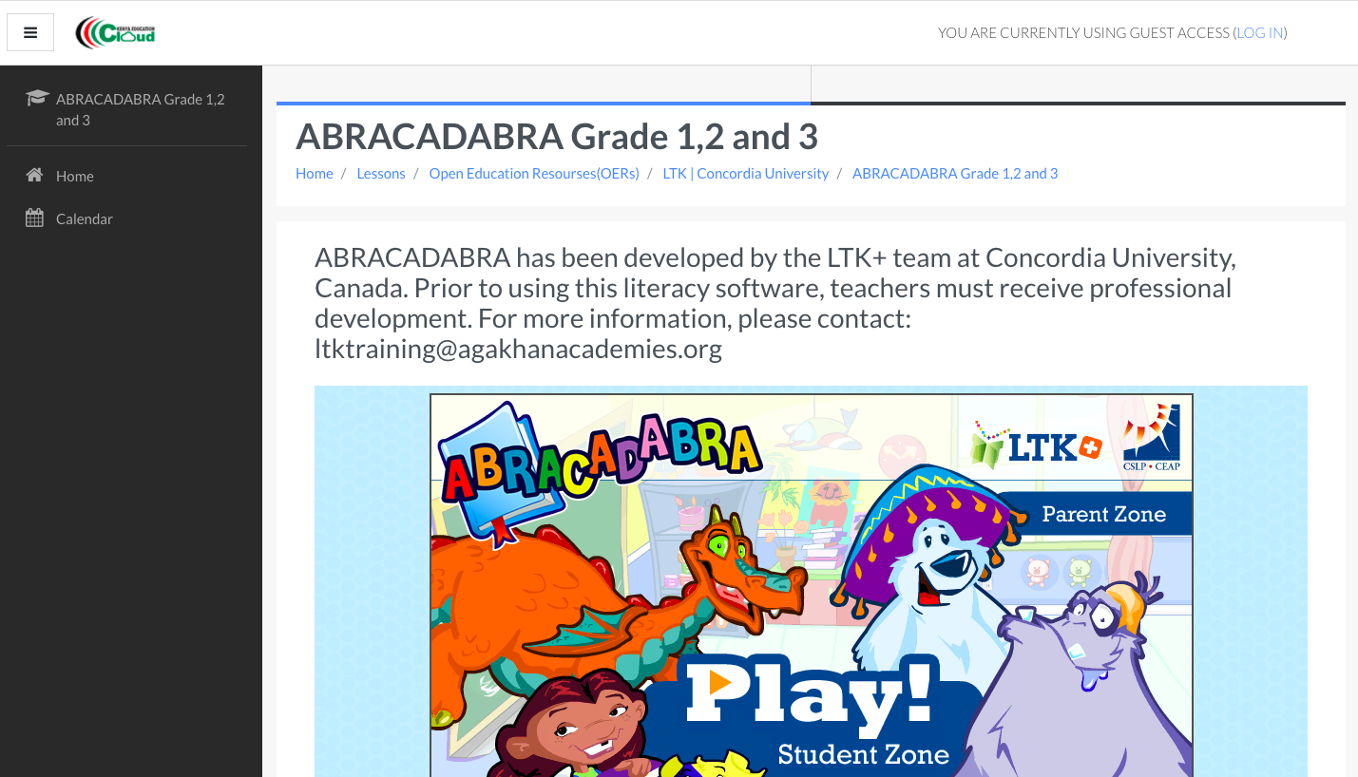
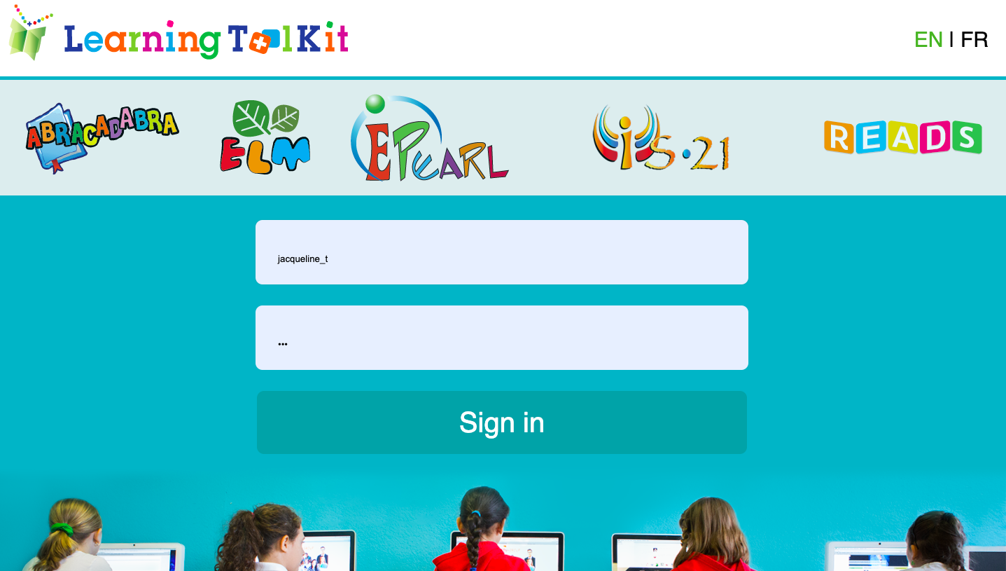
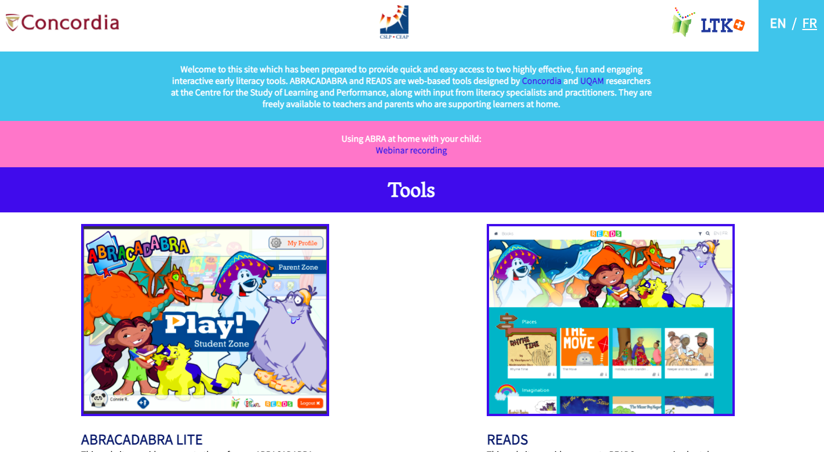
Accessing the Literacy Tools
There are three ways to access the Literacy Tools:
The Kenya Education Cloud
LTK+
Literacy Portal

Slide 2
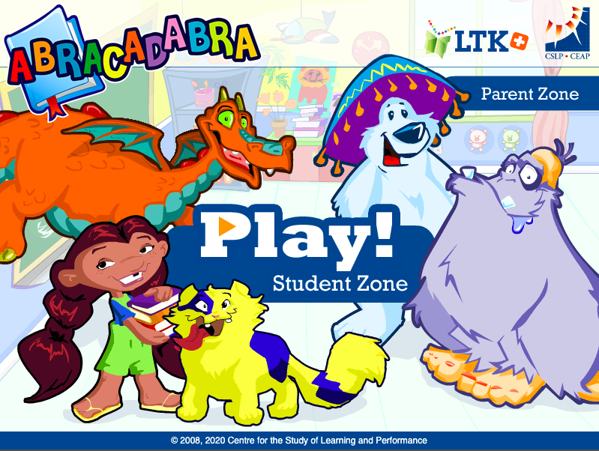
Step 1
Click on Play! to get started

Slide 3
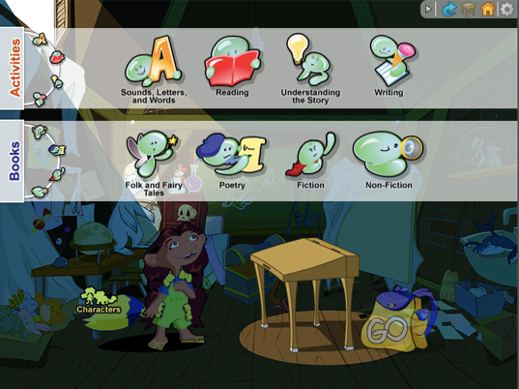
Step 2
Click one of the following activity sections:
Sounds, Letters, and Words
Reading
Understanding the Story
Writing

Slide 4
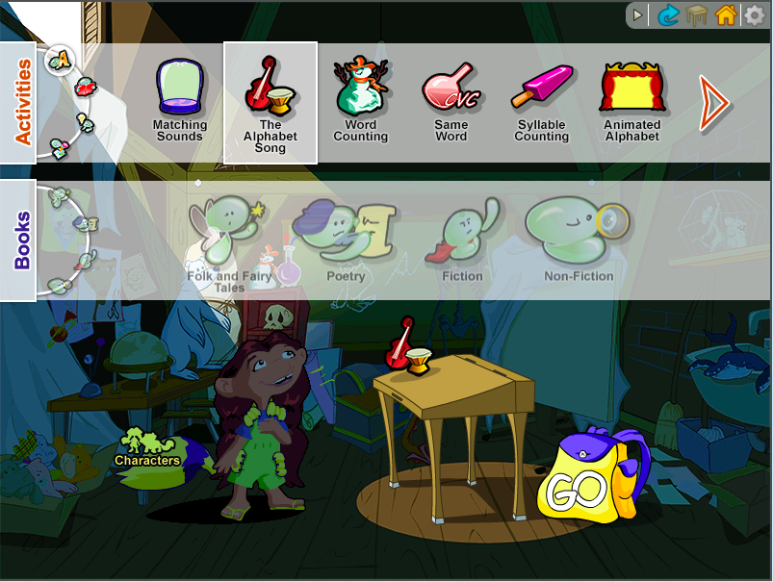
Step 3
Select the activity: The Alphabet Song.
You can go directly to the activity by clicking GO.
Notice that the book genre section is greyed out and you cannot connect to a book. This means that this activity isn’t linked to a book.

Slide 5

Step 4
To choose an activity in another section, click on one of the icons in the wheel.
Let’s try the second icon:
Tip: When you click on a new activity, it will replace the activity on the desk.

Slide 6
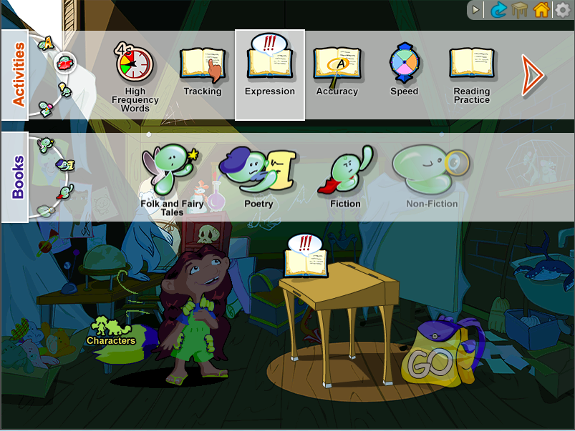
Step 5
Select the activity: Expression
Notice that GO is not yet illuminated. This means that you must connect the activity to a story.
Select a story genre in the second bar, then select a story of your choice.

Slide 7
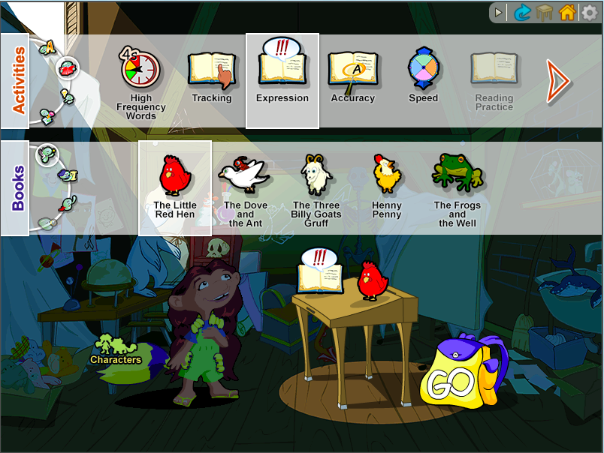
Step 6
Once an activity and a story have been chosen, GO will be illuminated.
Click on GO to be led to the activity demonstration.

Slide 8
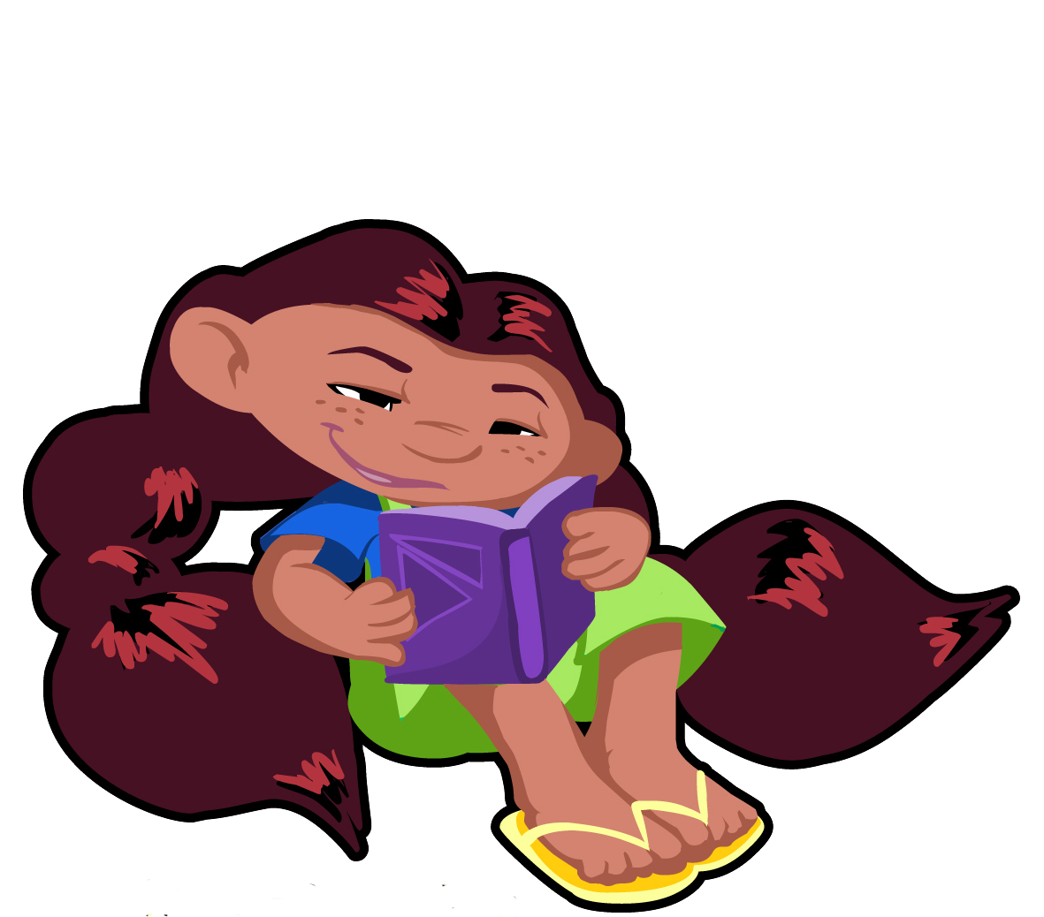
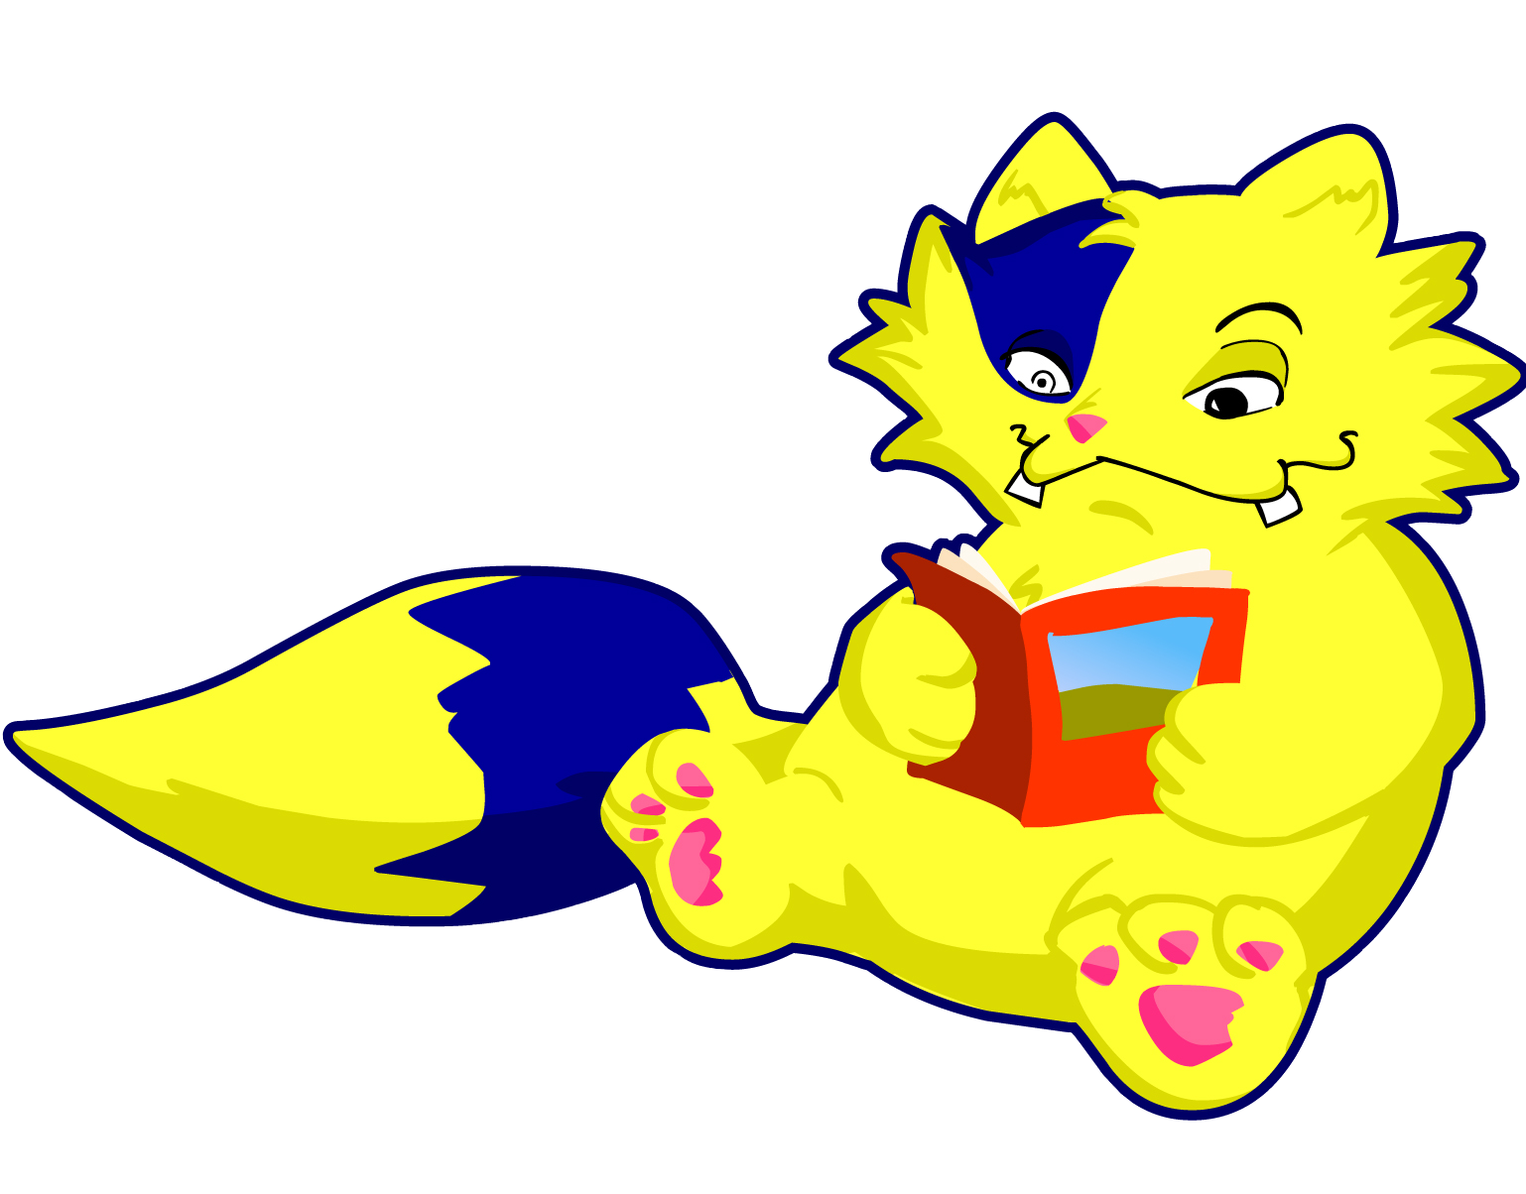
Step 7
For more information, consult the Getting Started with ABRA video on the Parent Site:
https://literacy.concordia.ca/resources/abra/parent/en/video_using_abra.php
0:00 – 1:28 explains how to select activities and books in the software
Explore the other sections of ABRA by connecting to different stories

